Slide 1

Welcome to Zoom 101!

Slide 2

Customer Success Team Lead – Atlanta
Nicole Gray – June 4, 2020
Notes:
Replace Image with a full width/height image

Slide 3




COMPETITION FOR TECH RESOURCES AT HOME
The new normal creates different ways people
will interact with PCs, accessories, and printers
SCHOOLS CLOSED
860 million
students
learning from home¹
INTERNET CONGESTED
20% increase
in web traffic reported by Verizon in past week²
LIVES DISRUPTED
2 of 3
parents say their lives
have been disrupted³
Bedroom Office / Theater
HOME OFFICE / HOMEROOM
LIVING ROOM / CLASSROOM
BEDROOM
IN THE OFFICE
96% of office
employees at home now⁴
63% lack a
dedicated work space⁴
41% of employees
compete with family to work on the couch⁴
13% end up working in the bedroom⁴
70% reduction
in business travel⁵
1. Forbes, March 18, 2020; 2. Verizon, March 17, 2020; 3. Kaiser, March 17, 2020; 4. HP Survey, 1100 end-users, US, UK, AUS, March 18, 2020;
5. Business Travel News, compared to normal, incl. emergency business travel, March 19, 2020
Notes:
TALK TRACK
We’ve always known there is remote work/learning happening, but we thought about it as 1:1. One member of a family would work from home, maybe full time or part time, so they had their setup and their workstyle.
But now it is multiple people in multiple spaces: Kids learning in the kitchen or the living room. Parents working in the home office or the bedroom. For all of these users, everyone needs a PC. How many displays do you need? How many printers?
With more people sharing the home network, what about security?
All of these users are vying for tech resources and internet bandwidth.
During this disaster and beyond, we need to consider these different settings and challenges and use this as an opportunity.
860M kids out of school: UN estimate, Mar. 18 2020
https://www.forbes.com/sites/carlieporterfield/2020/03/18/nearly-half-of-worlds-children-out-of-school-due-to-coronavirus/#66b8b2837ac0
Verizon report on increased network usage, Mar. 17 2020
https://www.hollywoodreporter.com/news/gaming-usage-up-75-percent-coronavirus-outbreak-verizon-reports-1285140
Disruption: Kaiser Family Foundation survey, Mar. 17 2020
https://www.kff.org/global-health-policy/poll-finding/kff-coronavirus-poll-march-2020/
53% of US respondents no longer comfortable going to stores to shop, 56% won't go to a restaurant, 58% won't go to the gym (Harris Poll, Mar. 18, 2020)
HP survey, 1100 end-users in US, UK, AUS, Mar. 18, 2020
Business Travel News, Tripbam Offers Hotel Booking and Cancellation Analysis To Gauge Covid-19 Recovery, Mar. 19 2020
“There still are some business travelers on the road… possibly about only 30 percent of the normal amount, at least as of the beginning of the week”
https://www.businesstravelnews.com/Procurement/Tripbam-Offers-Hotel-Booking-and-Cancellation-Analysis-To-Gauge-Covid-19-Recovery

Slide 4

Collaborate better with Zoom

Slide 5
Zoom Webinar or Zoom Meeting?
Zoom Webinar
Zoom Meetings
Content Sharing
Panelists only
All participants
Audio
Panelists only
All participants
Video
Panelists only
All participants
Best used for
Keynotes, Product Announcements, Educational Webinars, All Hands
Everyday meetings
Participants in ”Listen & View only” mode No interaction with eachother
Full interaction & collaboration between all participants

Slide 6
Schedule Meetings Using Outlook Meetings Only

Slide 7
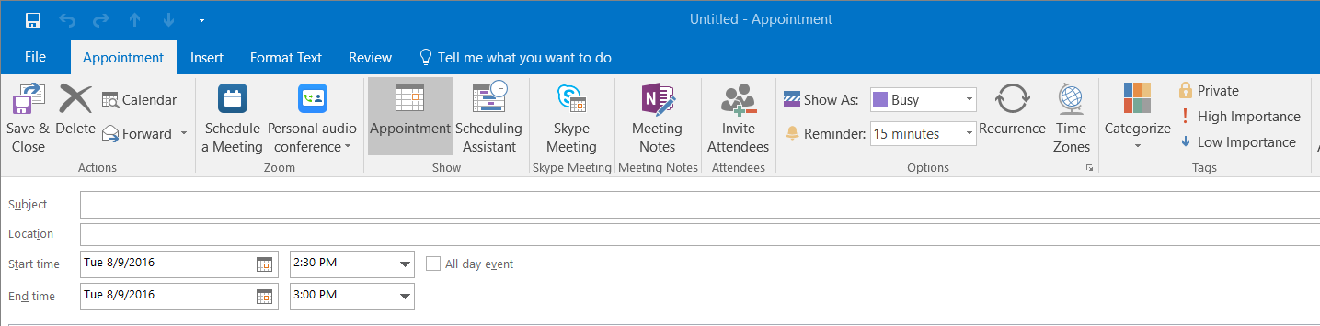
Scheduling a Zoom Meeting in Outlook
Step 1:Open a New Meeting
Screen shot to be added
Windows

Slide 8
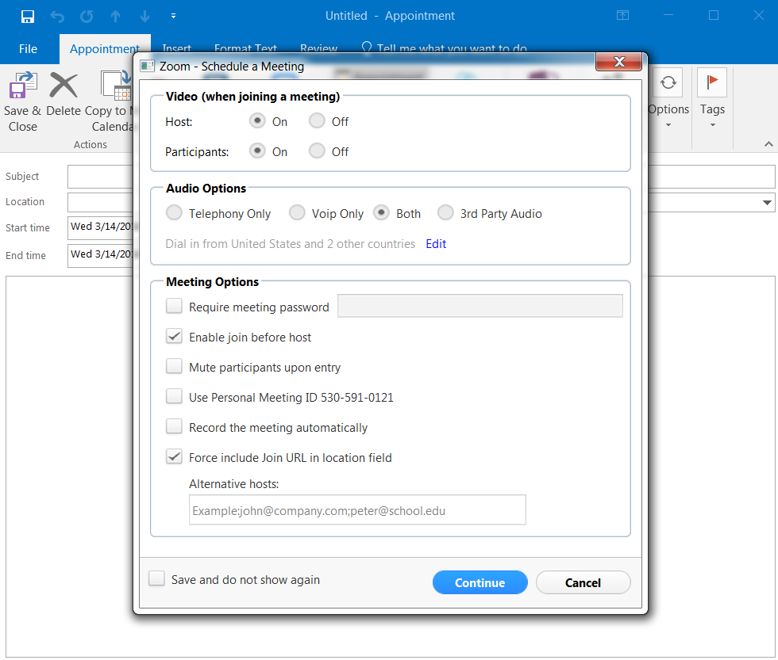

Scheduling a Zoom Meeting in Outlook
Step 2: Configure Meeting Settings
Windows
NOTE: THE DESKTOP CLIENT MUST BE RUNNING FOR THIS TO WORK

Slide 9
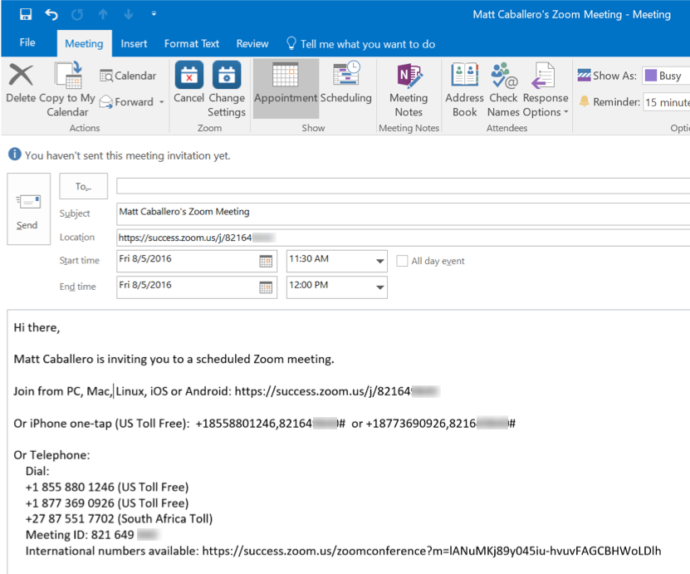
Scheduling a Zoom Meeting in Outlook
Step 3: Update Meeting Agenda
Windows

Slide 10
Schedule & Customize Your Webinar

Slide 11

Host vs Co-Host
 | Host | Co-Host | Attendee
Share Screen
In-meeting Chat
Mute/Unmute all
Answer poll
Promote Co-host
End Meeting

Slide 12
Hosting Your Webinar / Meeting

Slide 13
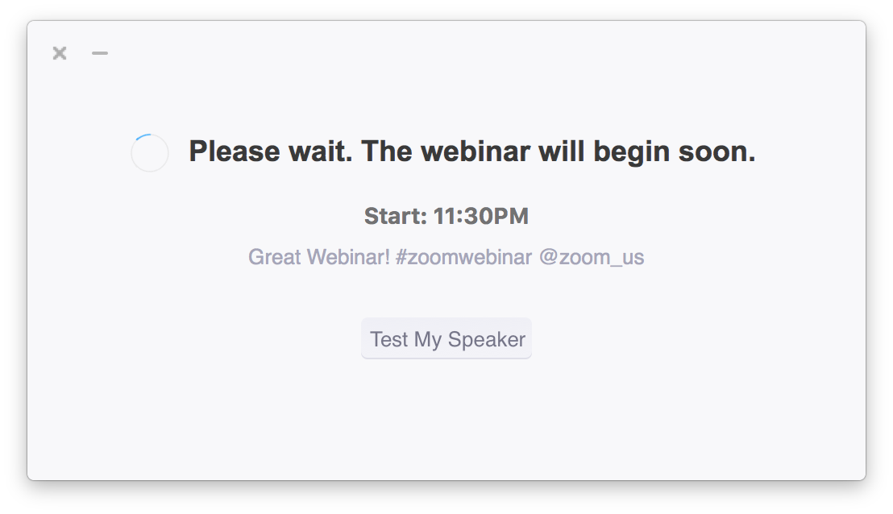
Attendee View – Waiting for Webinar to Start

Slide 14
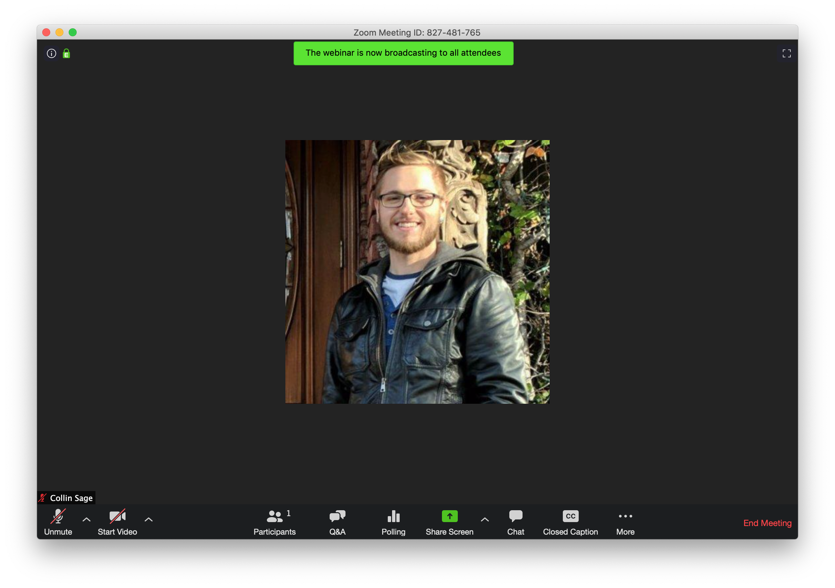
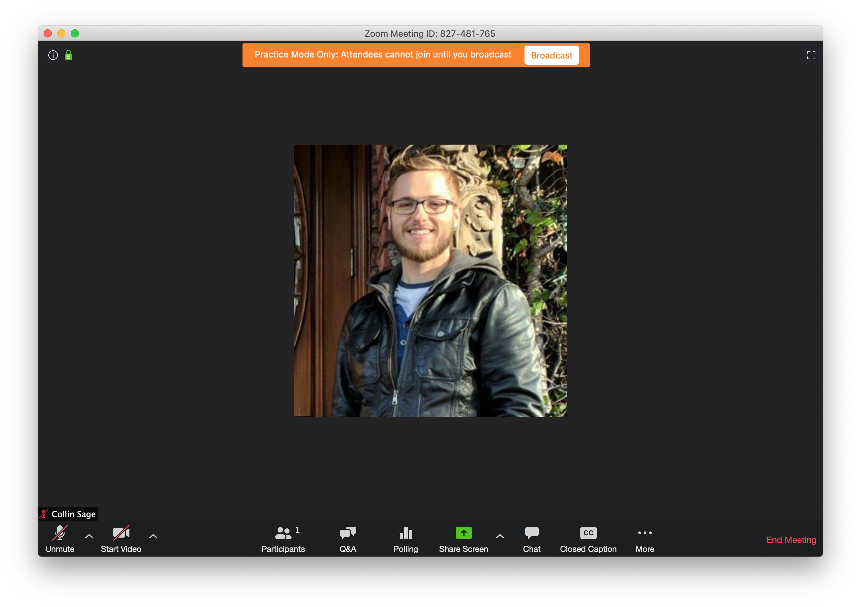
Starting in “Practice Mode”
Webinar Feature ONLY
Notes:
Practice Mode > Broadcast

Slide 15
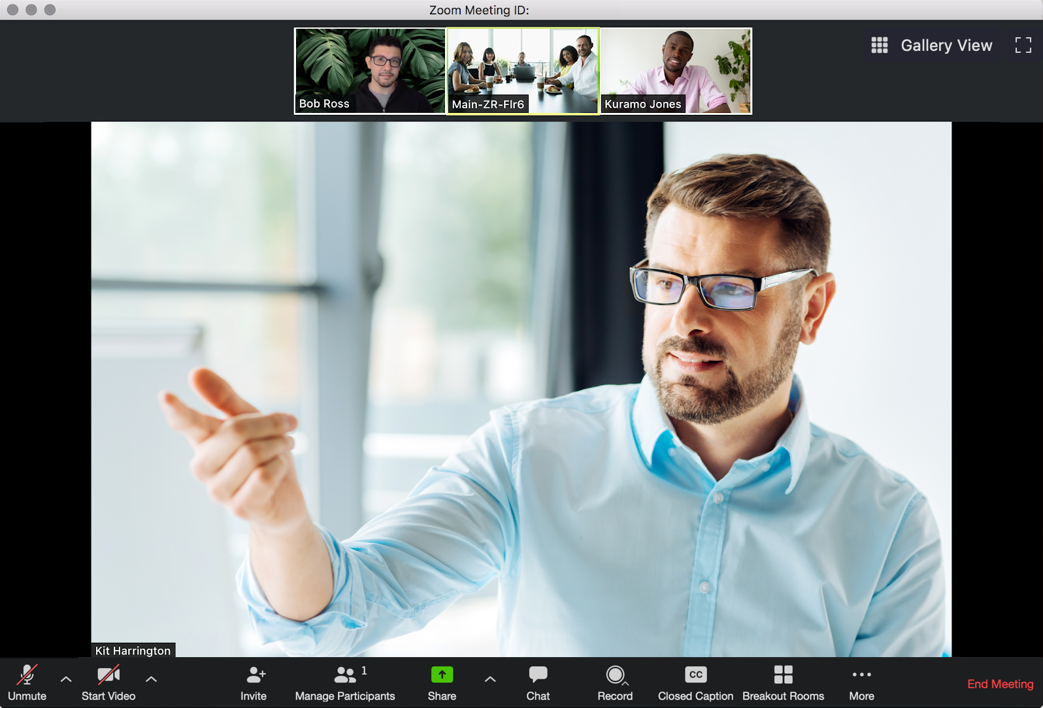

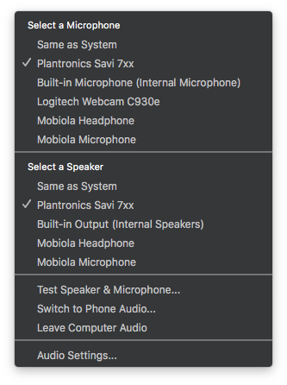
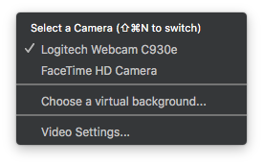
Zoom Meeting Controls
Meetings Feature / Available to Webinar Host & Panelists
Viewing Options
Mute Audio
End Meeting
Disable Video

Slide 16
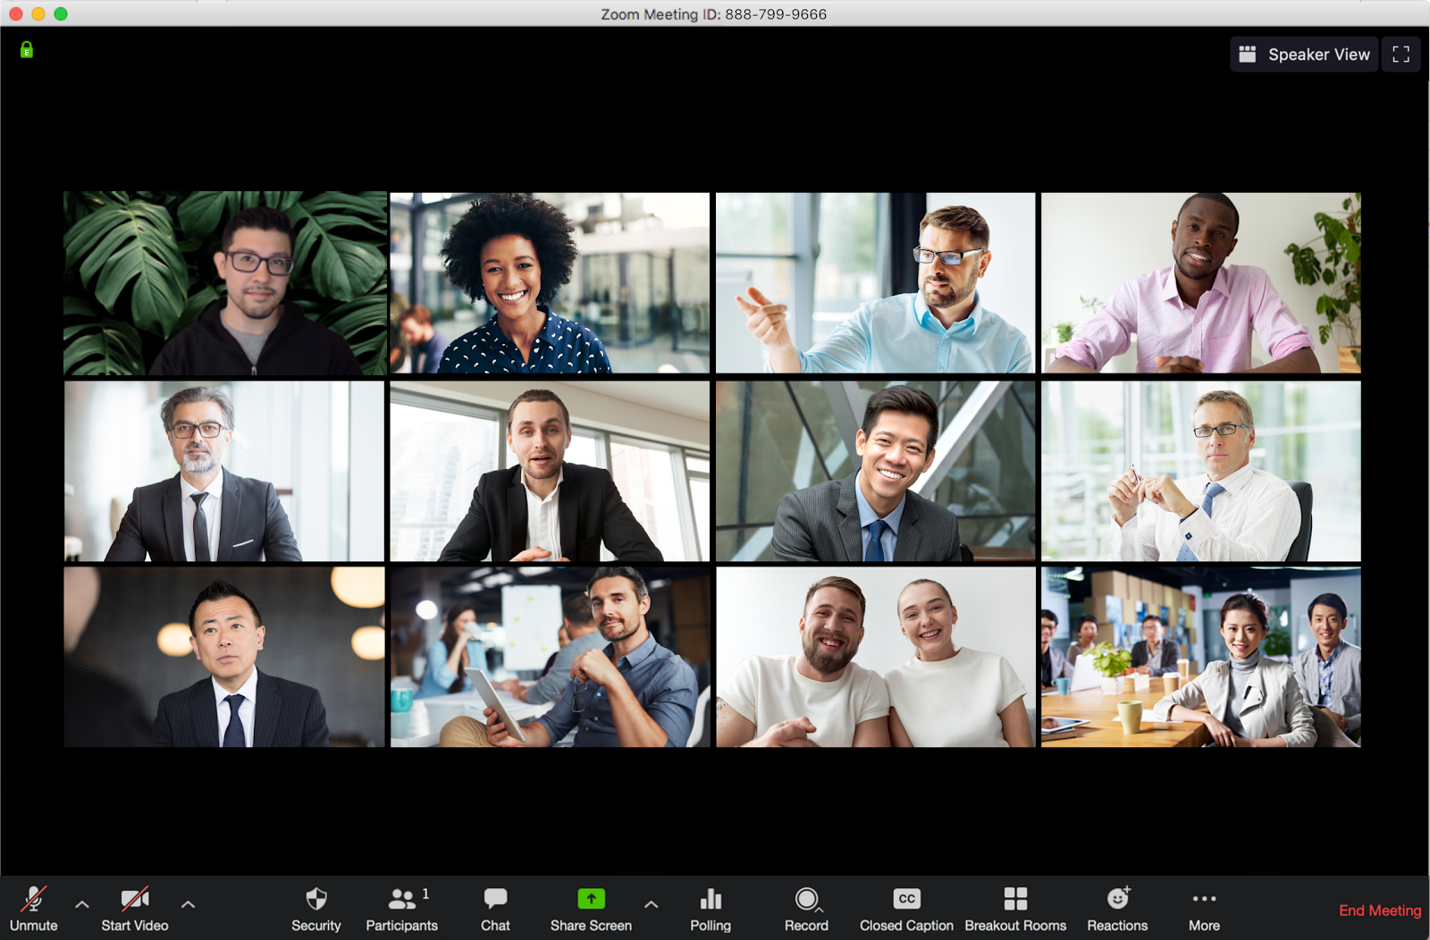
Viewing Options: Gallery View vs Speaker View

Slide 17
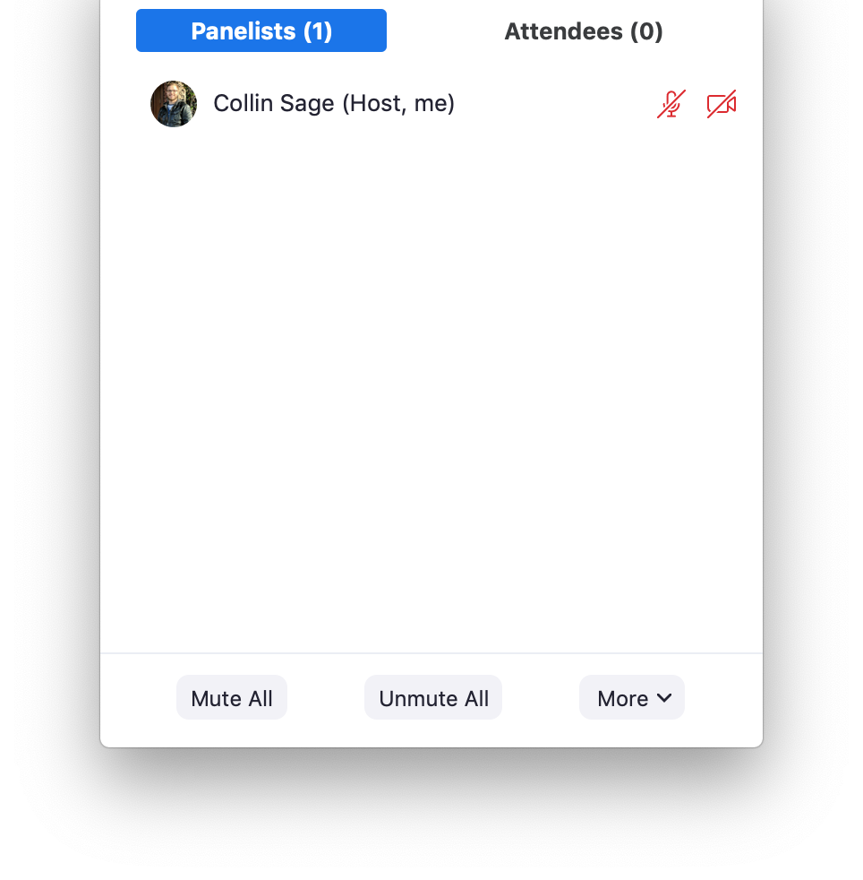
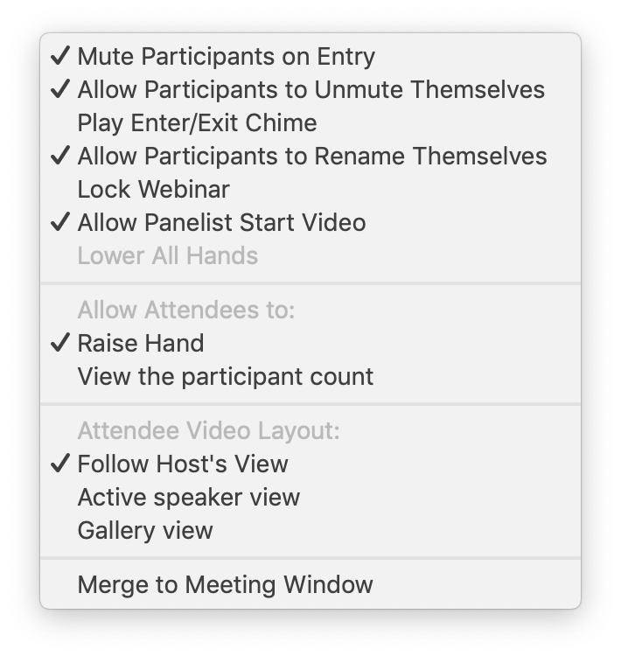
Participants // Settings
Webinar Feature ONLY
Notes:
Only while sharing content

Slide 18
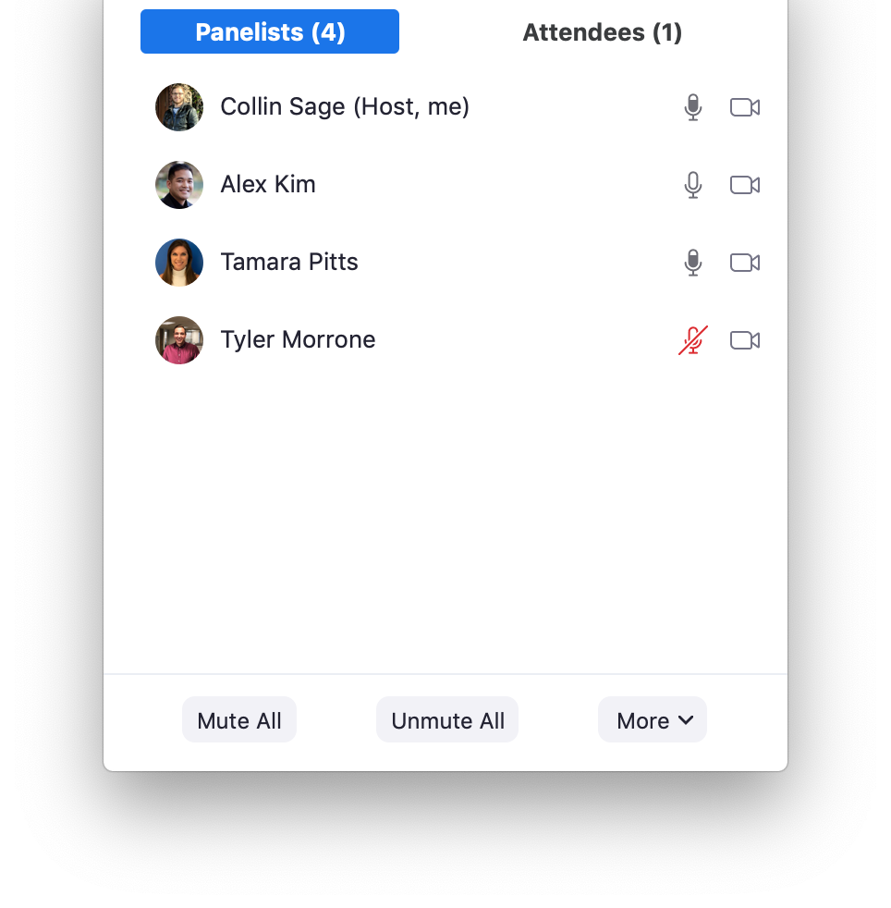
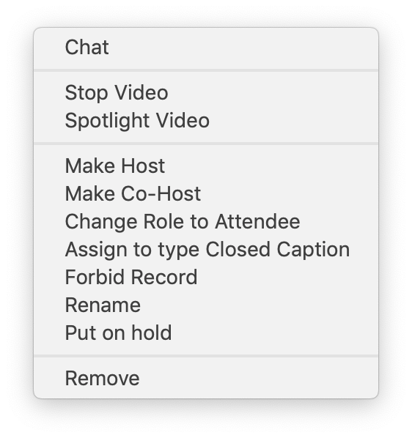
Participants // Panelists
Webinar Feature ONLY

Slide 19
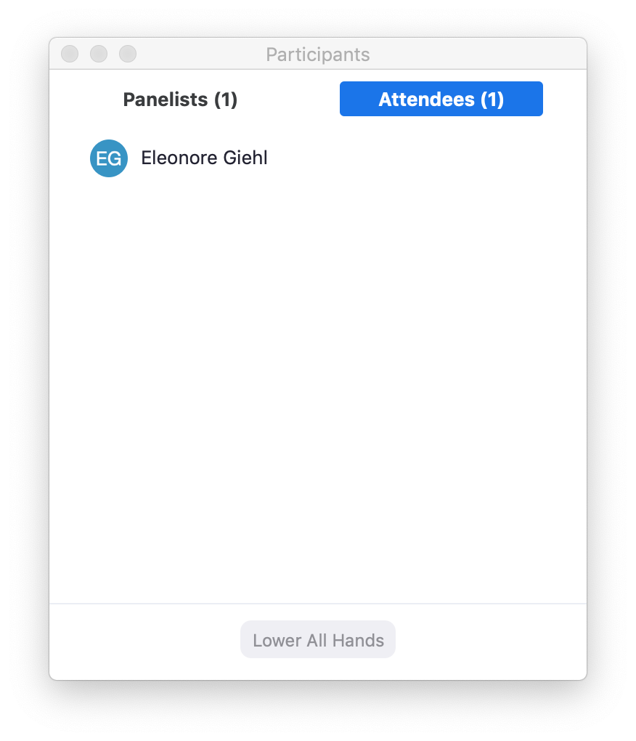
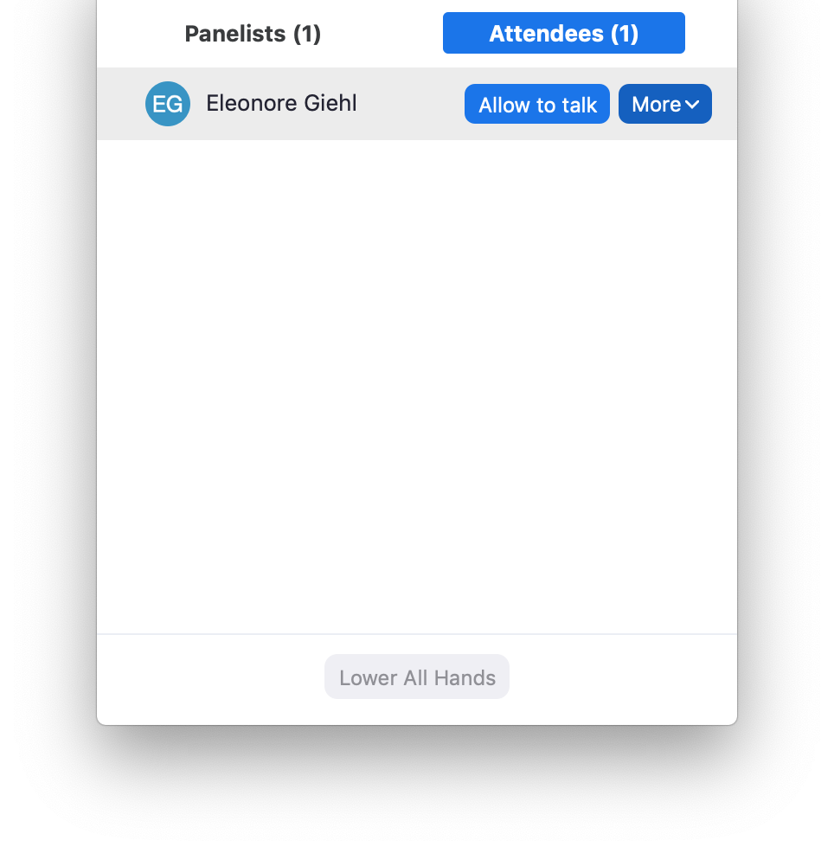
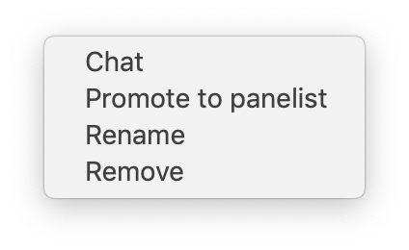
Participants // Attendees
Webinar Feature ONLY

Slide 20
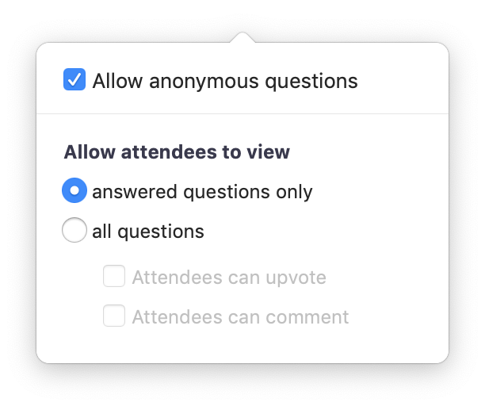

Managing Q&A // Settings
Webinar Feature ONLY

Slide 21
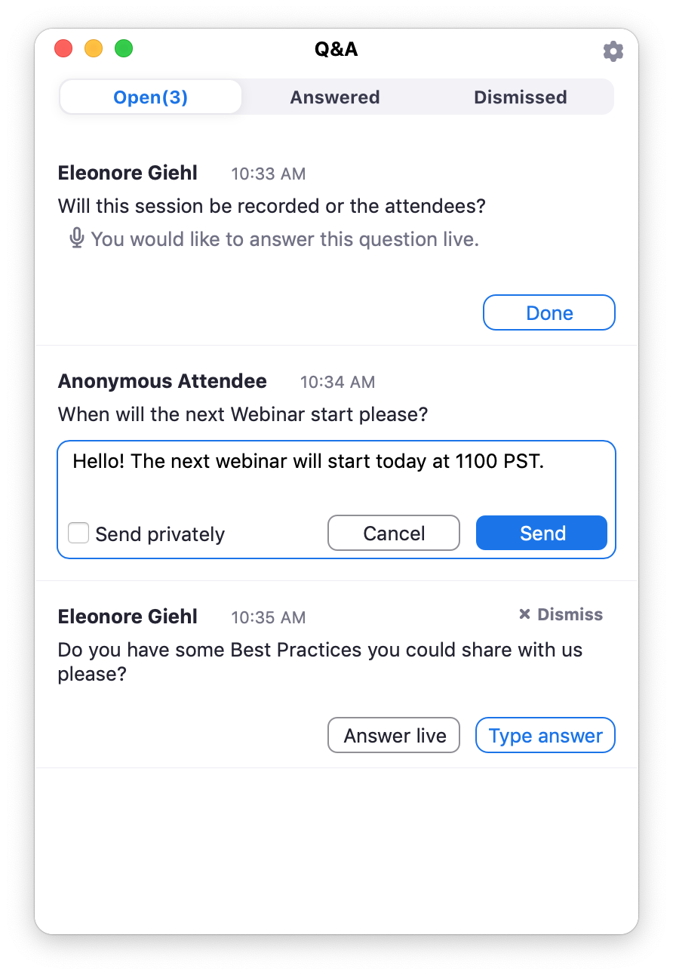
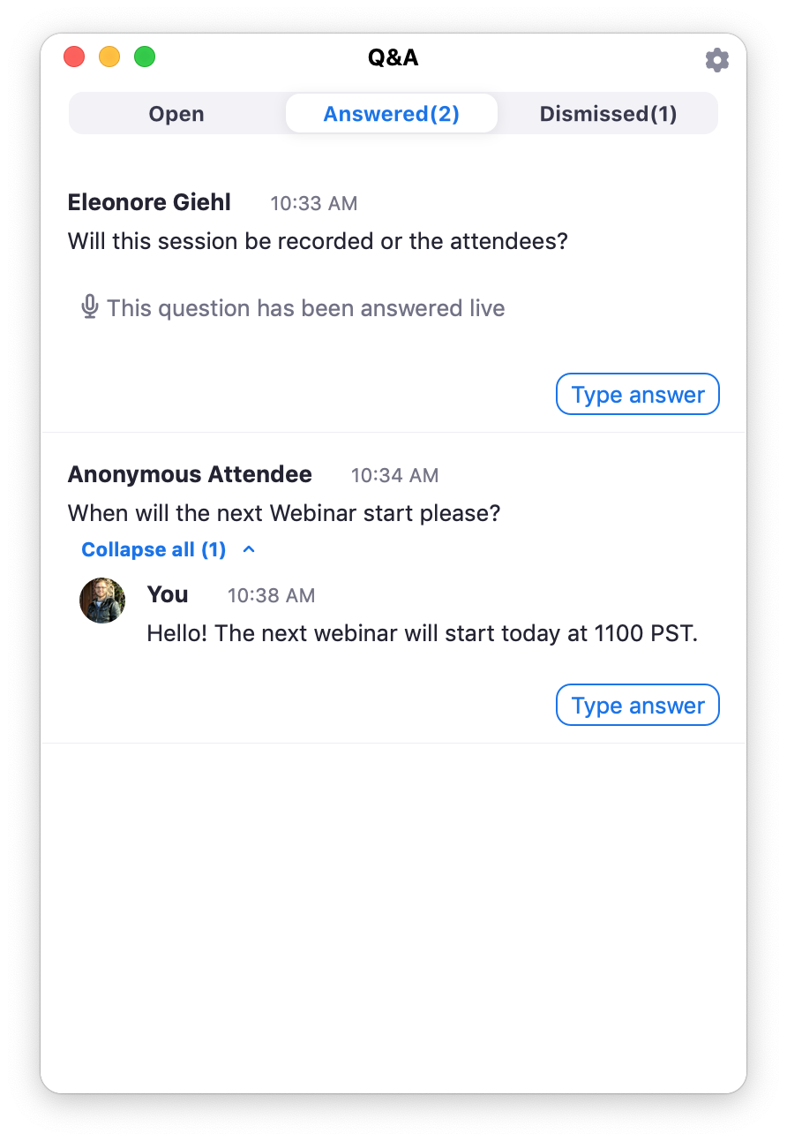
Managing Q&A // Questions
Webinar Feature ONLY
Notes:
Click Path:
1) Hal >> Answer Live, click Done
2) Hal's Little Sister >> Type Answer, Send Privately

Slide 22
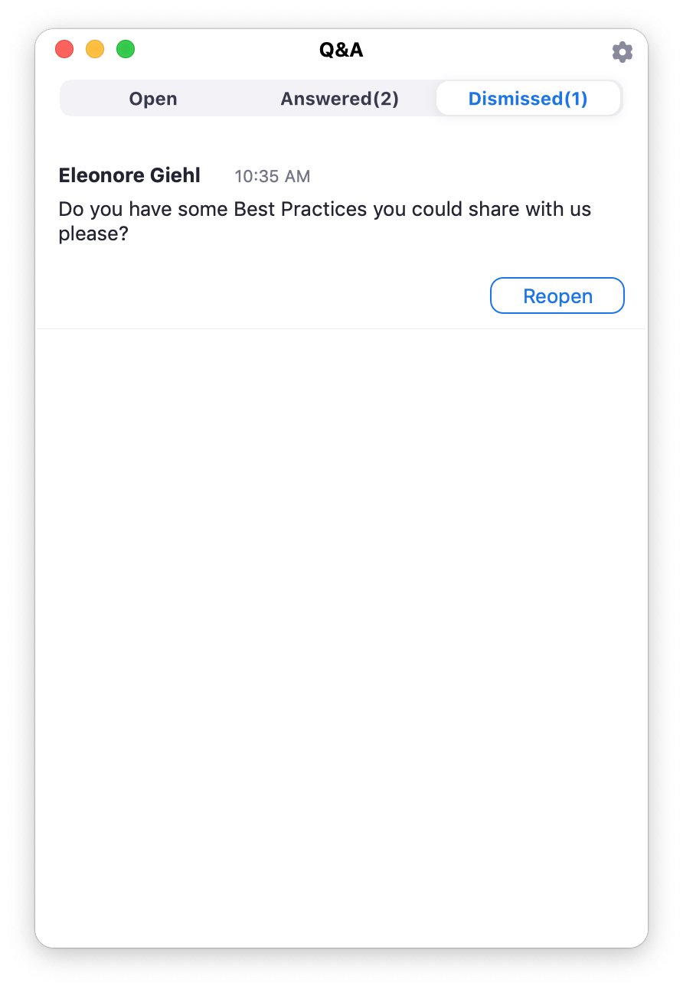
Managing Q&A // Questions
Webinar Feature ONLY
Notes:
Click Path
1) Example of, "Voting" on questions
2) Example of, Attendees "Commenting" on questions
3) Click, "Dismiss" >> Emily Wemily's question
4) Click, "Dismiss" >> Emily Wemily's, "Thank you"
5) Click (show) Dismissed Column

Slide 23
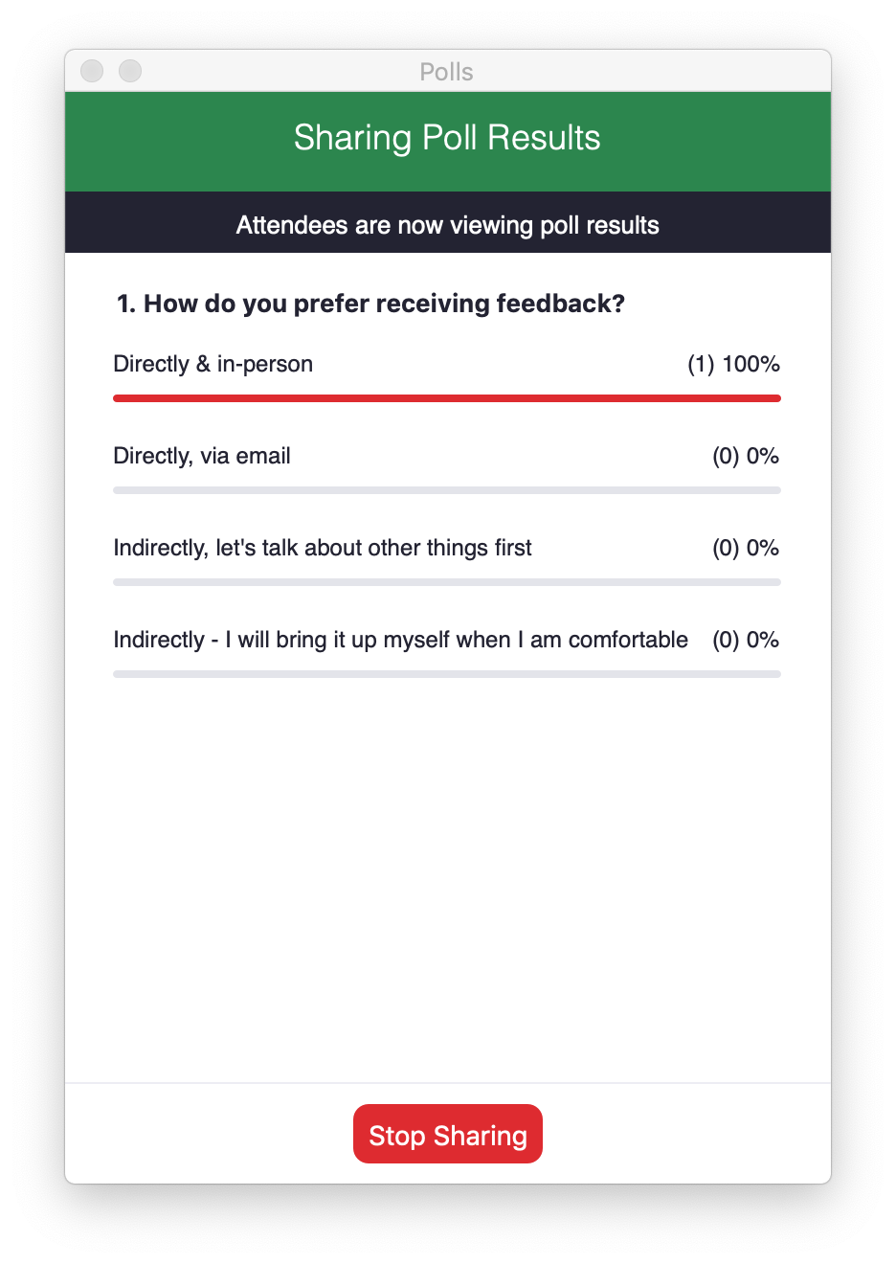
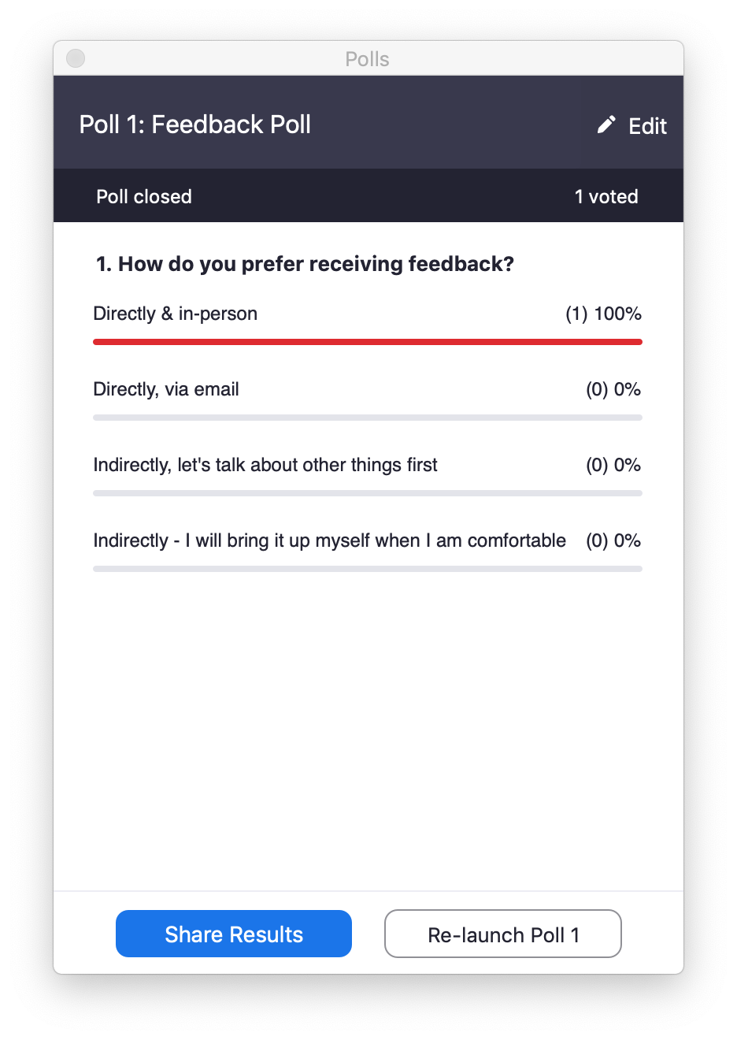
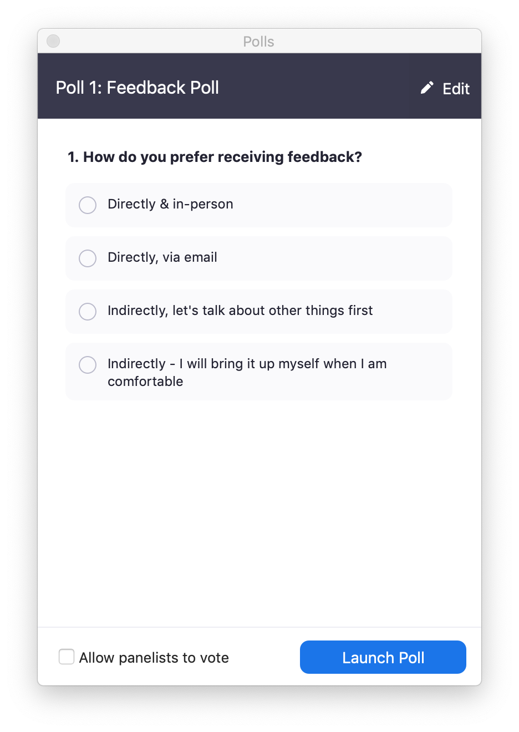
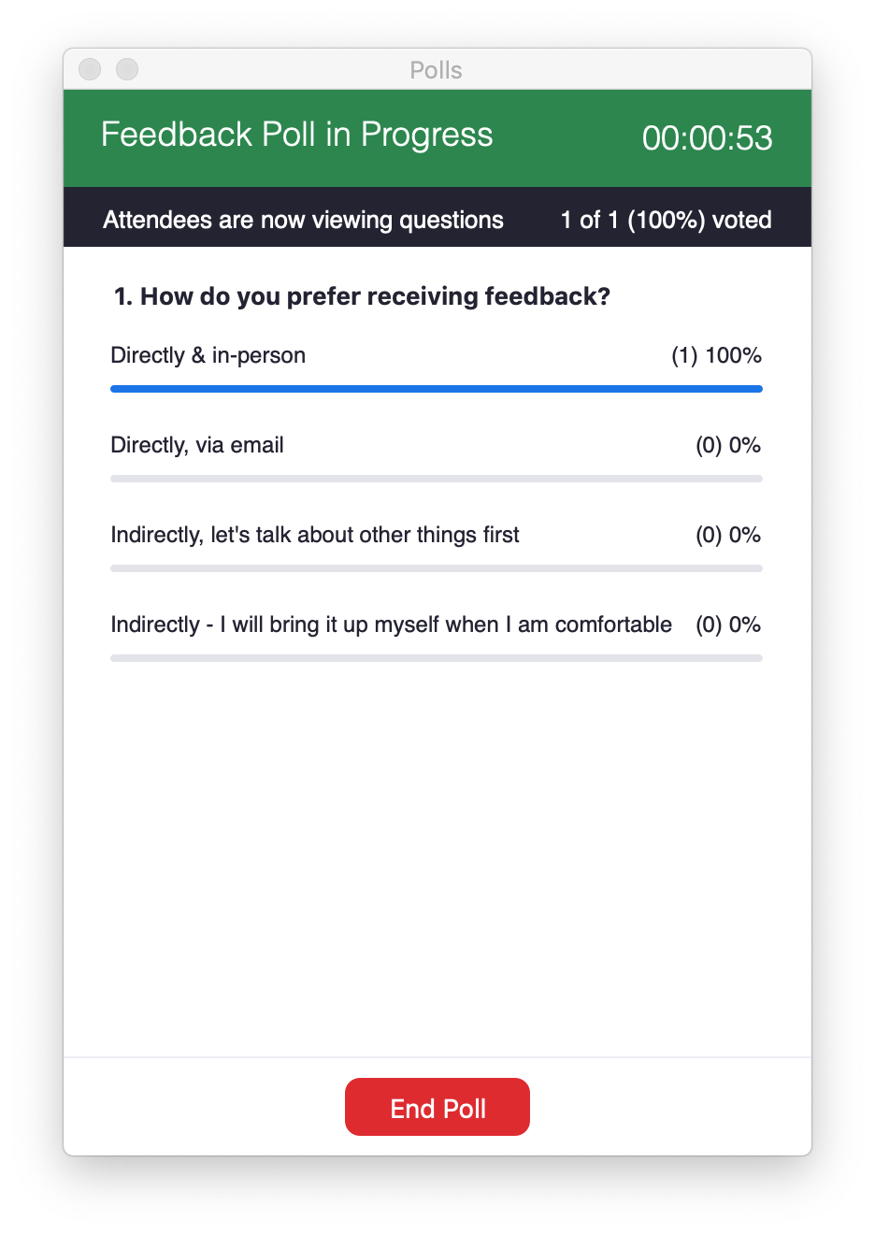
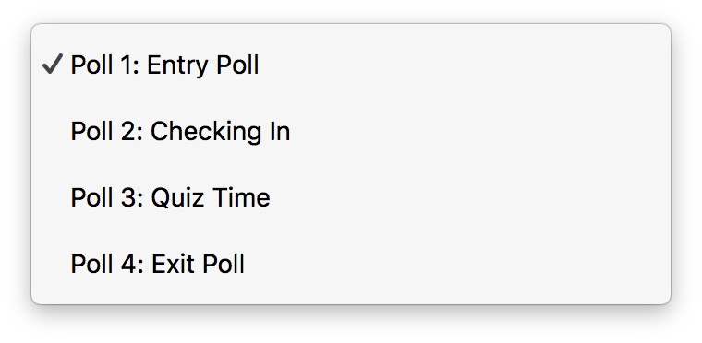
Poll Management
Meetings & Webinar Feature

Slide 24
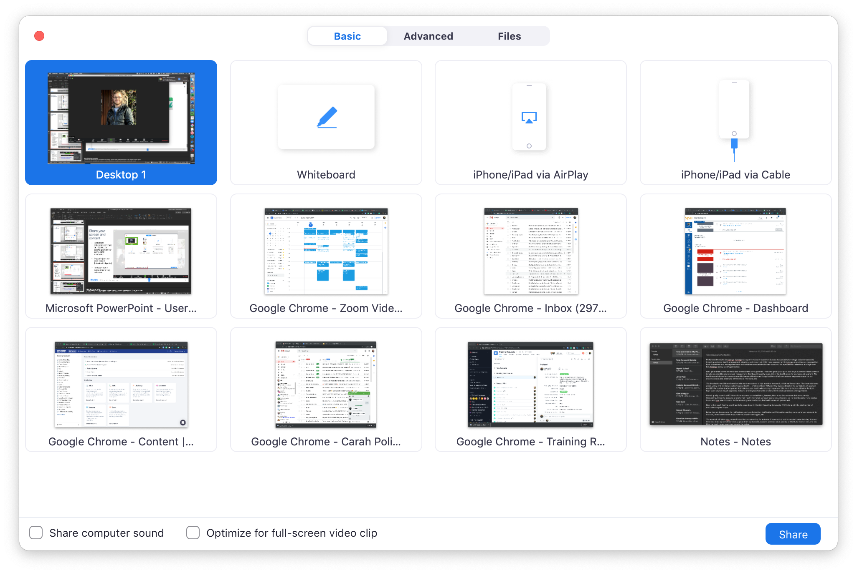
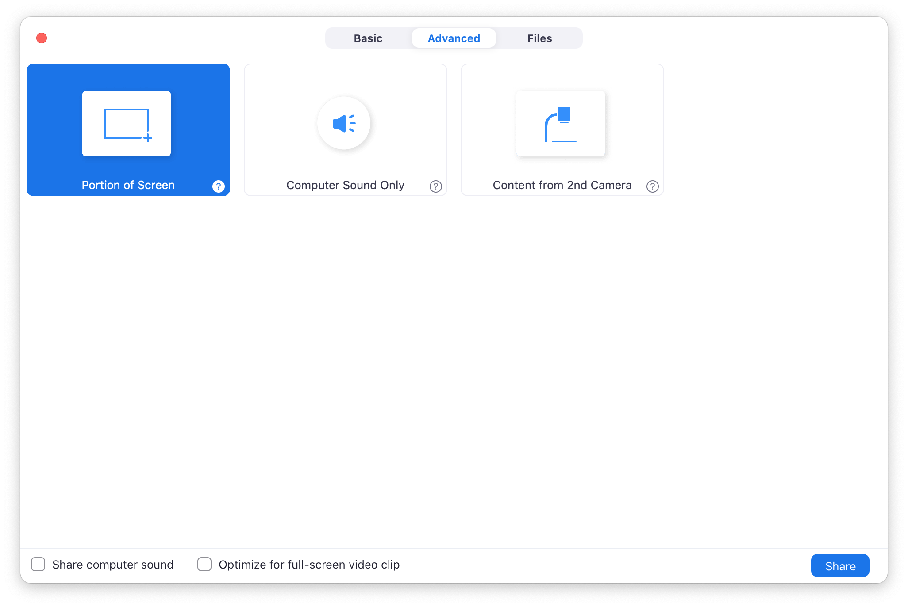
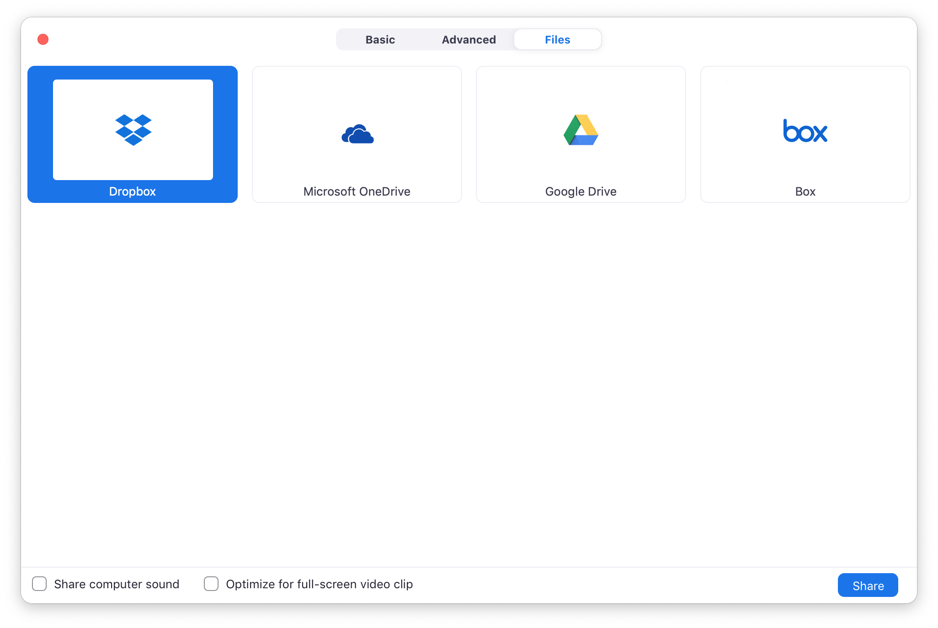
Share screen and content
Meetings Feature / Available to Webinar Host & Panelists

Slide 25
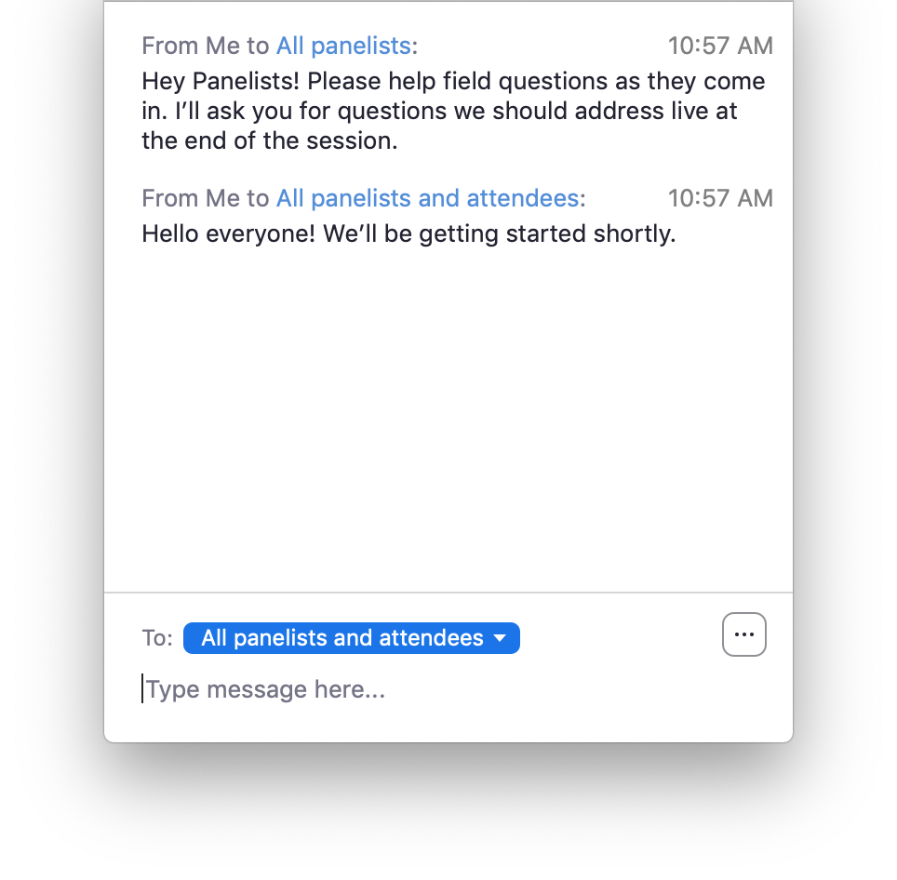
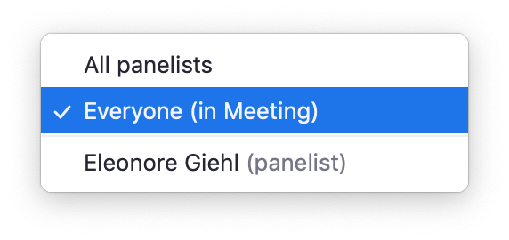
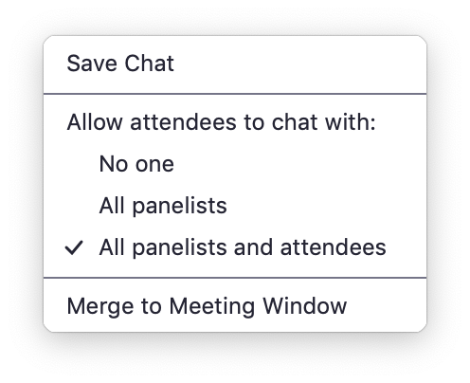
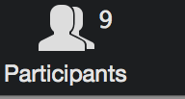
Webinar
Chat
Meetings & Webinar Feature (Host Only)

Slide 26
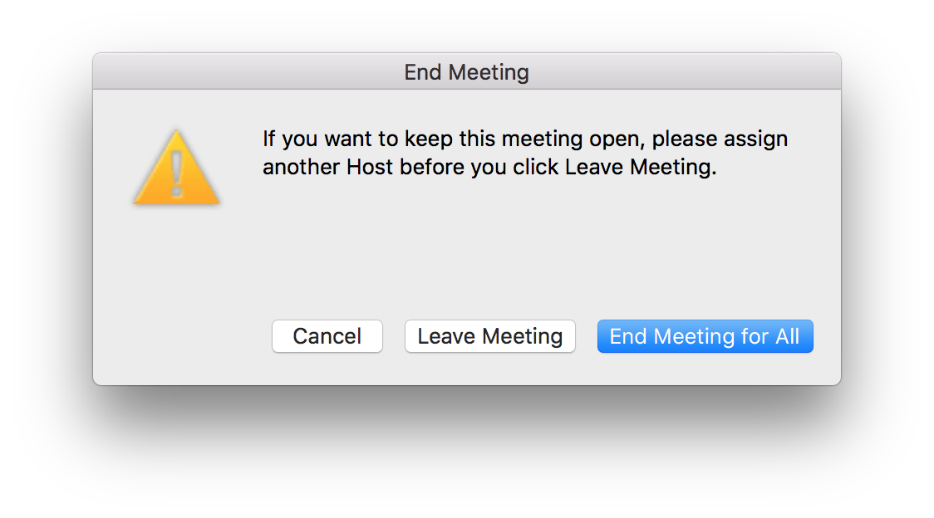
Ending the Webinar
Meetings & Webinar Feature (Host Only)
Notes:
End Meeting > "End Meeting for All"

Slide 27
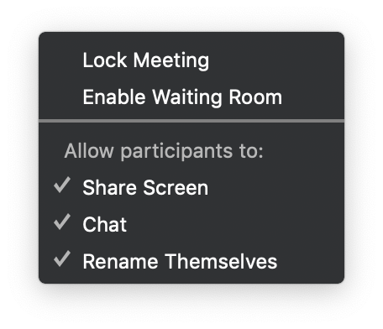
Security for Your Meeting

Slide 28
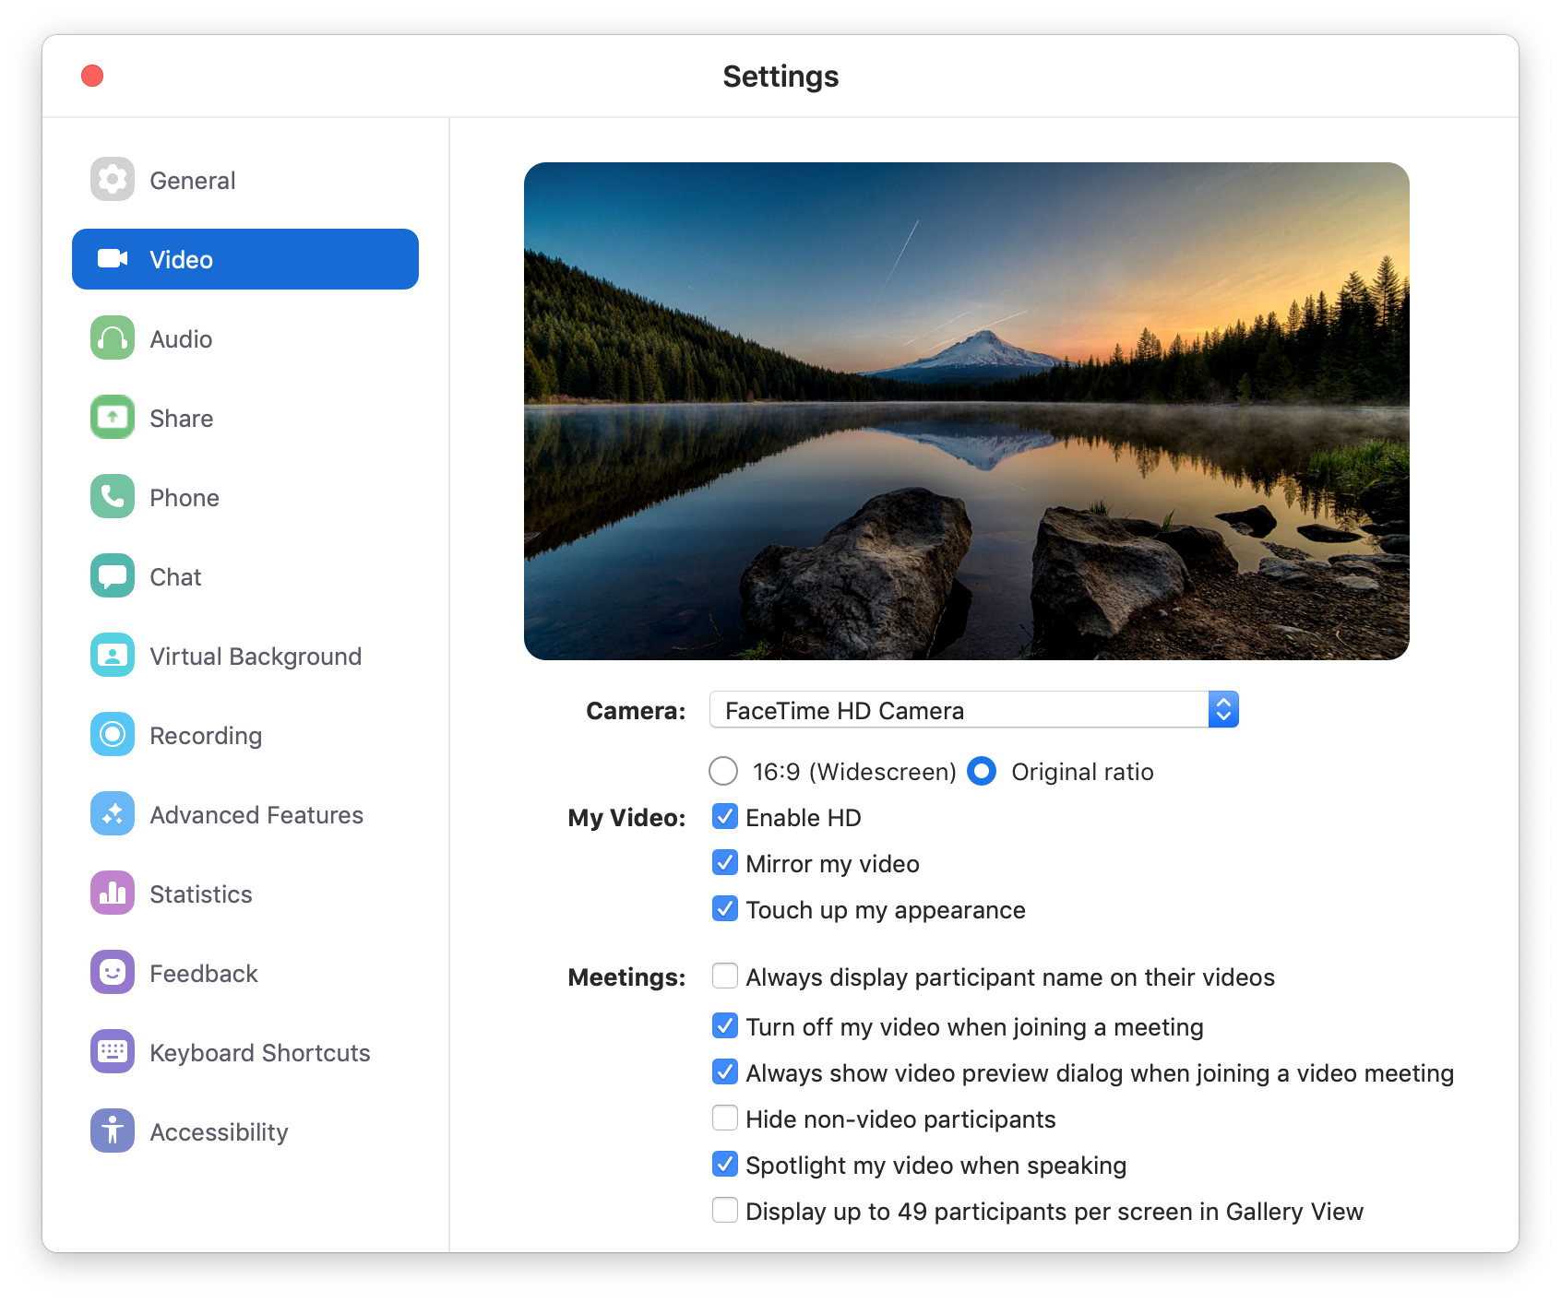
Zoom Desktop Application
Video Preferences

Slide 29
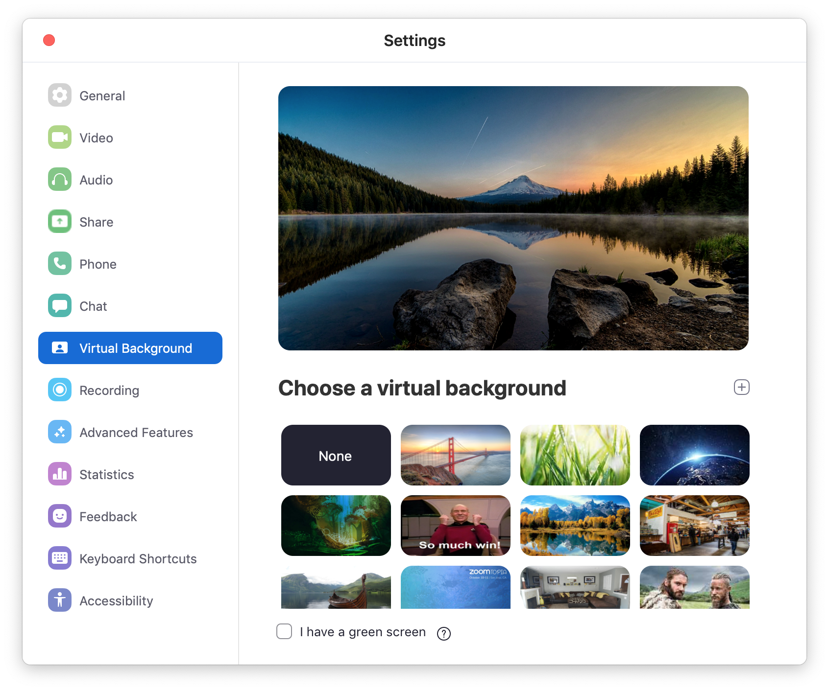
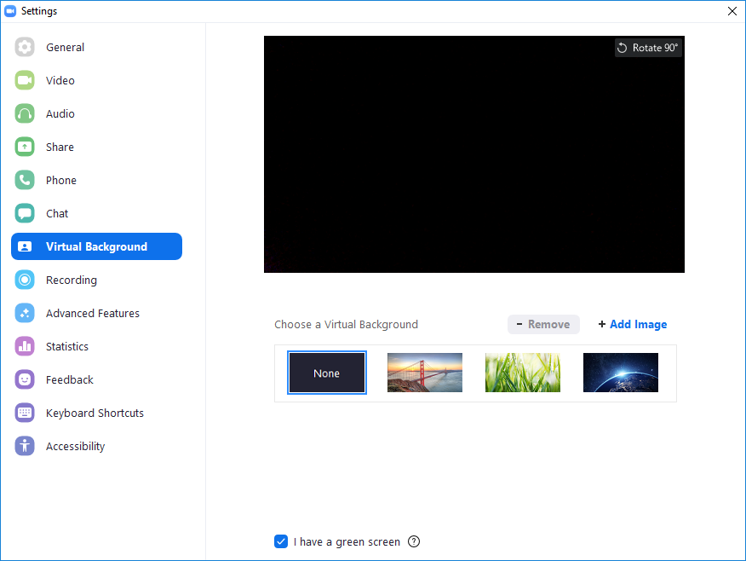

Zoom Desktop Application
Virtual Background
Mac
Windows

Slide 30
Virtual Background best practices
1920x1280 or larger images recommended
Save your images in a folder for quick access
If you are experiencing issues with Virtual Background, try the following troubleshooting tips:
If you do not have the Virtual Background tab in your Desktop Client settings after enabling it, sign out of the client and sign in again.
Manually pick the background color to ensure the correct color is selected. This option is only available after you click an image.
Ensure that the background is a solid color with minimal shadows. Also ensure the background is uniform in lighting.

Slide 31
Tips & Best Practices
Before the Meeting:
Test your Audio and Video
Have the content you intend to share (ex. Power point)ready in advance
Make sure the lighting around you is good – the round selfie lights are always good to use
Hosting a Meeting:
Mute your microphone if others are presenting/speaking
Use Gallery View for collaborative meetings
Share your screen
Share specific applications to control displayed content
Use “New Share” to seamlessly transition between shared applications
Use the Annotation feature to grab and direct attention
Turn your camera on:
Position your webcam at, or slightly above eye level
Be sure to check that it’s not the top of your head or your chin
Make eye contact – try to look at your webcam as often as possible
Or you can look at others directly and that looks like your looking into your camera

Slide 32


Smile and have fun!
Wear bright colors to your Zoom meetings/webinars

