Slide 1
Now What? 10 Decisions to Make in a Trans-Pandemic World
Michael Blake
Director, Strategic Advisory Services
Brady Ware & Company

Slide 2
Disclaimers
It is assumed that grownups are watching this presentation and are capable of making their own decisions.
The views expressed in this presentation are mine.
This is an 80/20 presentation – I am sacrificing detail for clarity.
You agree not to sue me if you act on any information offered here and things don’t work out.
None of the content contained herein should be construed as an investment recommendation.
None of the content contained herein should be construed as a legal opinion.
Don’t ever do anything without advice of legal counsel.
If you find any spelling mistakes, you may keep them.

Slide 3
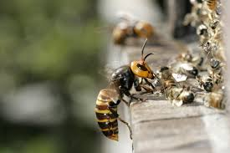
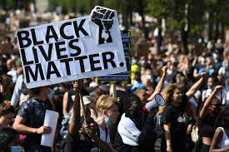
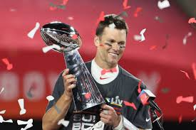
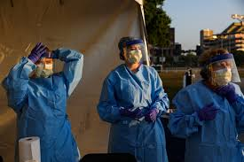
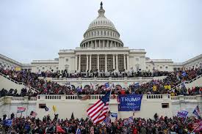
A Fun Year!

Slide 4
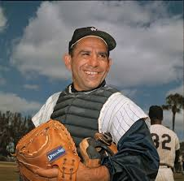
But Now the World Has Changed…
“When you come to a fork in the road, take it.” - Yogi Berra.

Slide 5
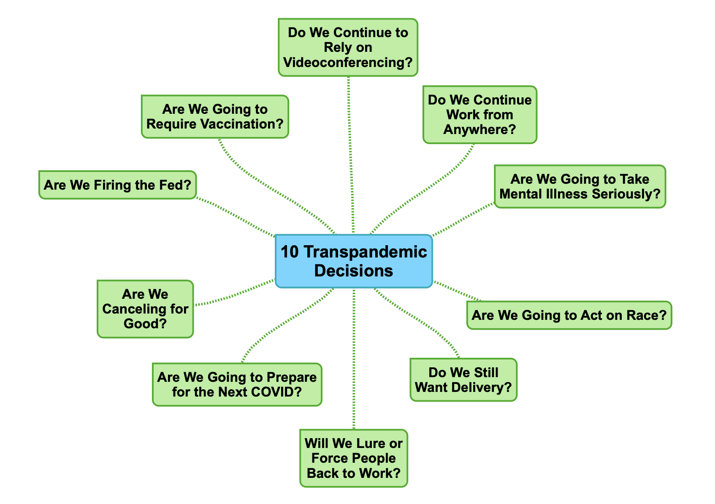
Today’s Outline

Slide 7
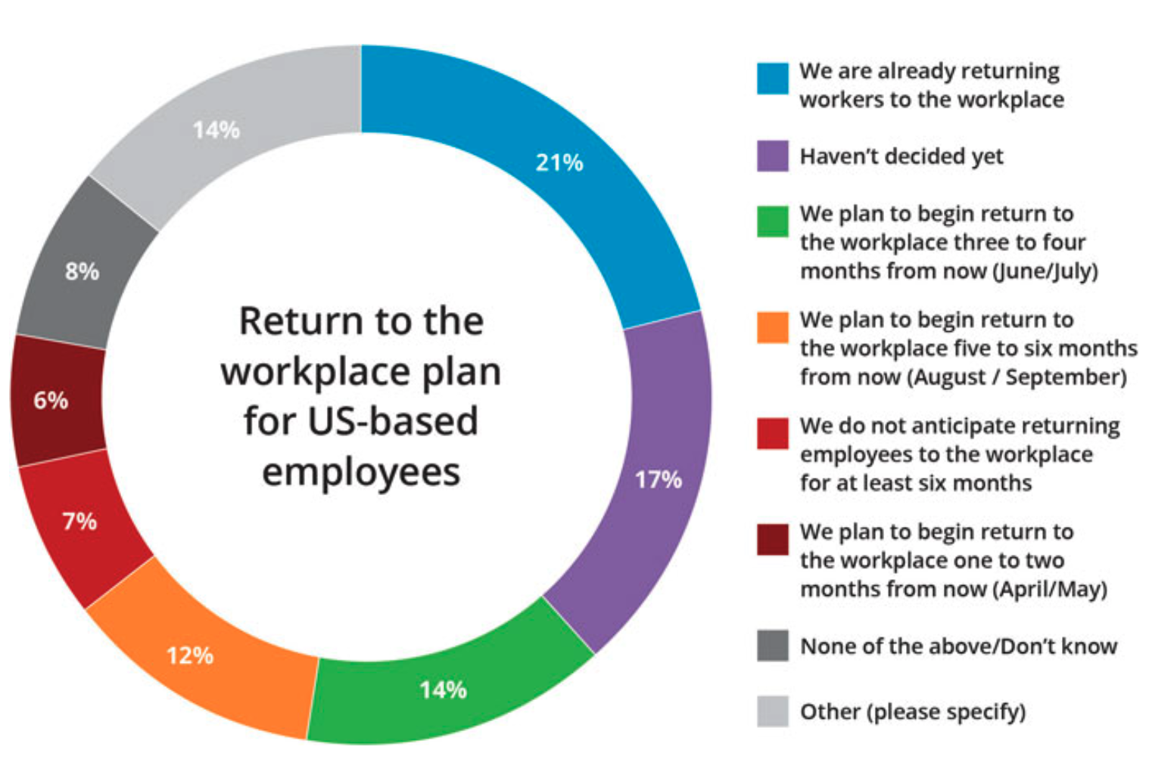
Should We Go Back to the Office?
Samdahl, Erik. “When Will U.S. Workers Return to the Office? Over 50% of Employers Have a Plan.” Institute for Corporate Productivity (i4cp), 1 Apr. 2021, www.i4cp.com/coronavirus/when-will-u-s-workers-return-to-the-office-over-50-of-employers-have-a-plan.

Slide 8
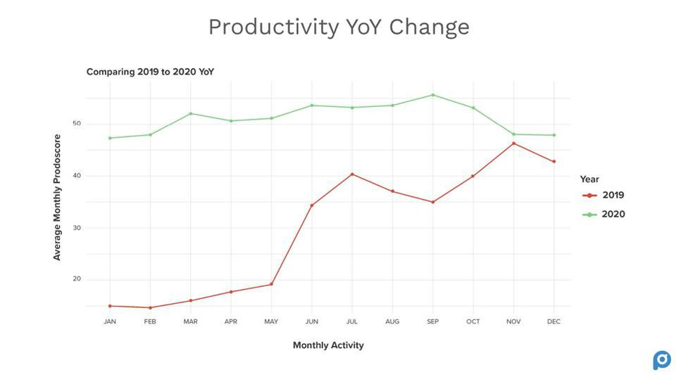
The Productivity Picture is Positive
Pontefract, Dan. “Productivity Better Be Top Of Mind In A Post-Pandemic Hybrid Work World.” Forbes, Forbes Magazine, 4 June 2021, www.forbes.com/sites/danpontefract/2021/06/04/productivity-better-be-top-of-mind-in-a-post-pandemic-hybrid-work-world/?sh=3ca90dd75a58.

Slide 9
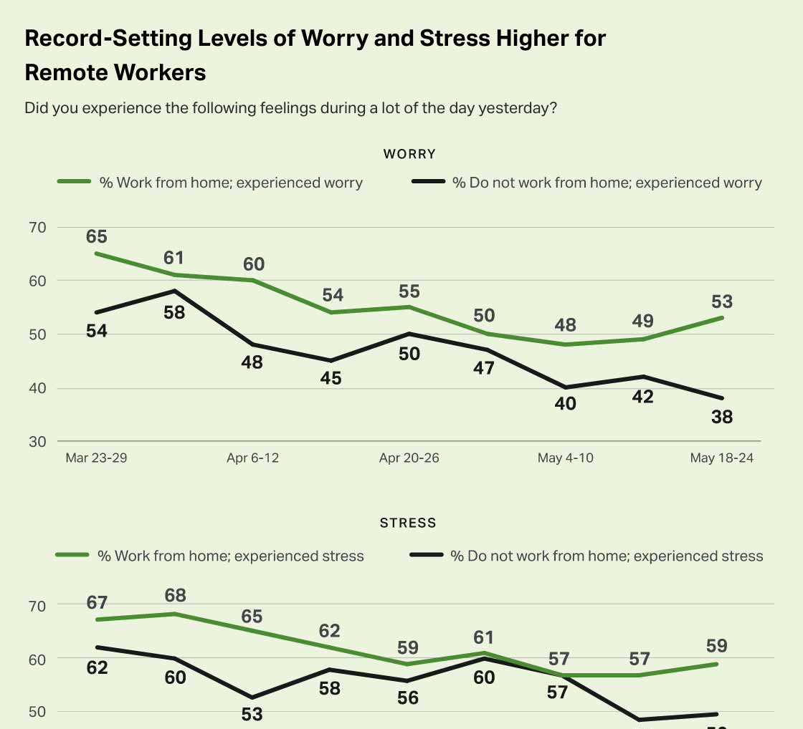
But the Productivity Story is More Complex
Gallup, Inc. “Succeeding With Remote Work.” Gallup.com, Gallup, 14 June 2021, www.gallup.com/workplace/316313/understanding-and-managing-remote-workers.aspx.
Notes:
Predicted Total Actions by month. Note: This figure plots the month‐specific fixed effect coefficients estimated from a regression of total actions on controls for examiner, expectancy, grade level, and year. Treatment (WFA) is indicated with the red vertical line
IF THIS IMAGE HAS BEEN PROVIDED BY OR IS OWNED BY A THIRD PARTY, AS INDICATED IN THE CAPTION LINE, THEN FURTHER PERMISSION MAY BE NEEDED BEFORE ANY FURTHER USE. PLEASE CONTACT WILEY'S PERMISSIONS DEPARTMENT ON PERMISSIONS@WILEY.COM OR USE THE RIGHTSLINK SERVICE BY CLICKING ON THE 'REQUEST PERMISSIONS' LINK ACCOMPANYING THIS ARTICLE. WILEY OR AUTHOR OWNED IMAGES MAY BE USED FOR NON-COMMERCIAL PURPOSES, SUBJECT TO PROPER CITATION OF THE ARTICLE, AUTHOR, AND PUBLISHER.

Slide 11
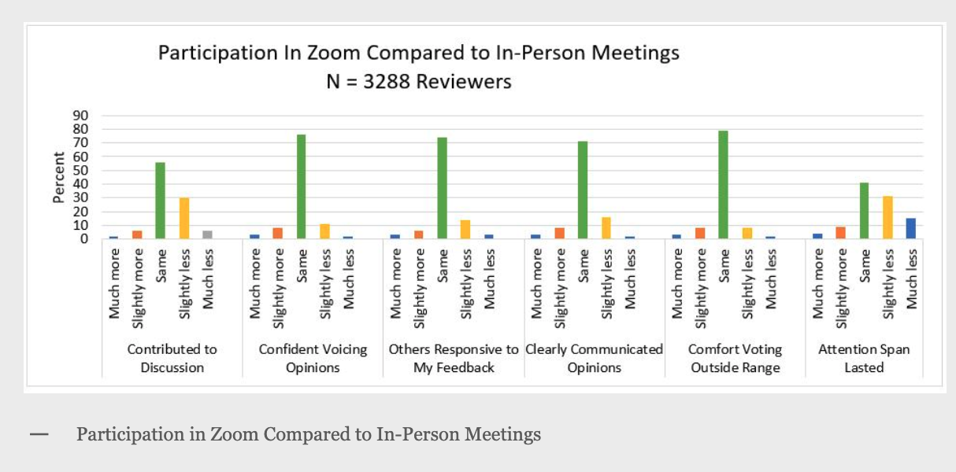
Zoom Seems a Substitute But Not Replacement for Meetings.
Reed, Bruce. “Open Mike.” National Institutes of Health, U.S. Department of Health and Human Services, 2 Dec. 2020, nexus.od.nih.gov/all/2020/11/19/should-we-keep-meeting-this-way/.

Slide 12
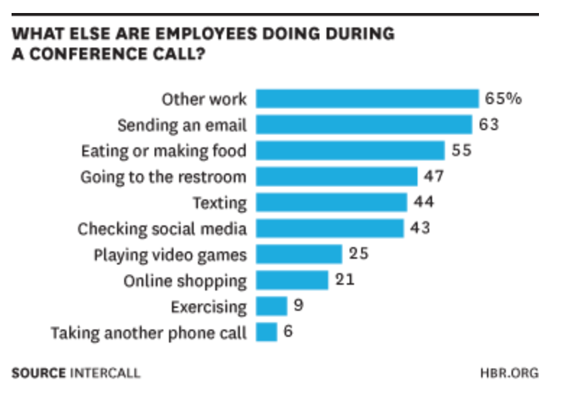
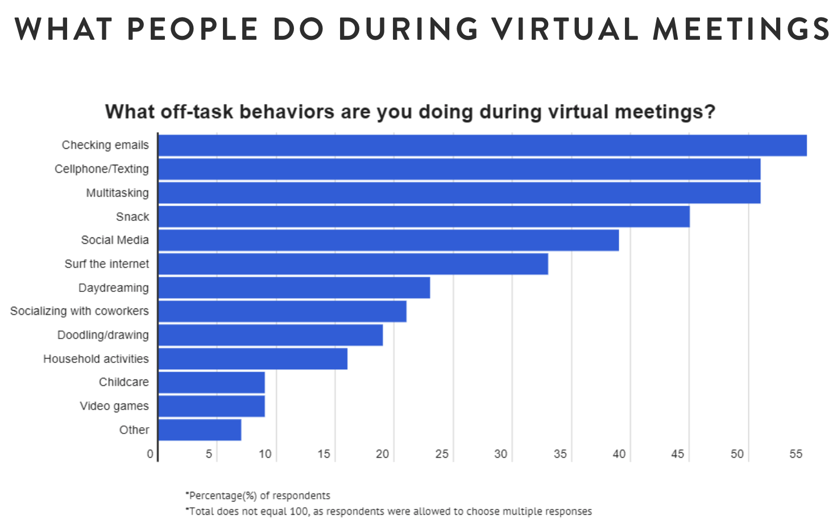
Is Anybody There?
2014 Study
2020 Study
Gavett, Gretchen. “What People Are Really Doing When They're on a Conference Call.” Harvard Business Review, 6 Dec. 2017, hbr.org/2014/08/what-people-are-really-doing-when-theyre-on-a-conference-call.
Morris, Kathy. “Survey: Most People Are Distracted During Virtual Meetings.” Zippia, 12 Feb. 2021, www.zippia.com/advice/virtual-meetings-zoom-survey/.

Slide 13
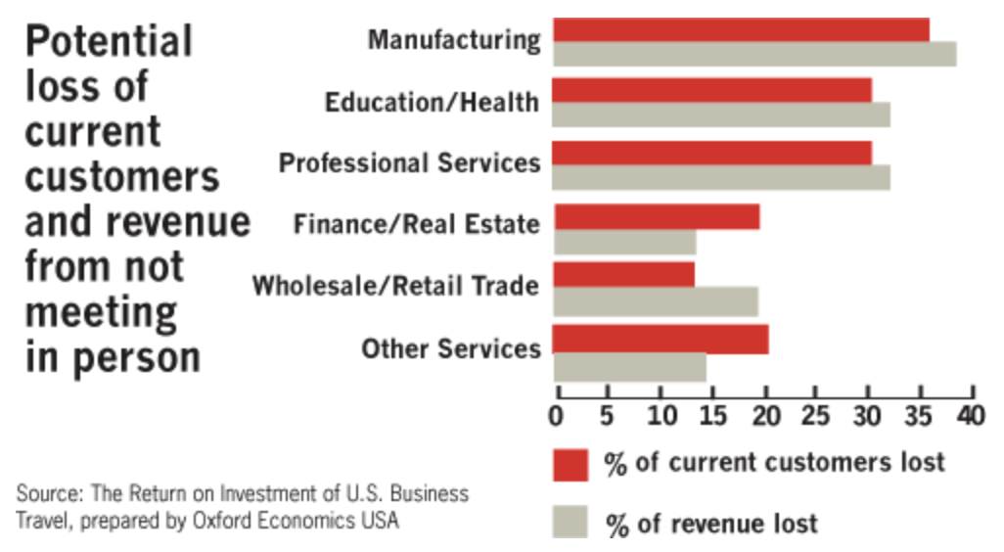
Virtual is Costing Money
Mullich, Joe. The Wall Street Journal, Dow Jones & Company, 2020, www.wsj.com/ad/article/globaltravel-face.

Slide 15
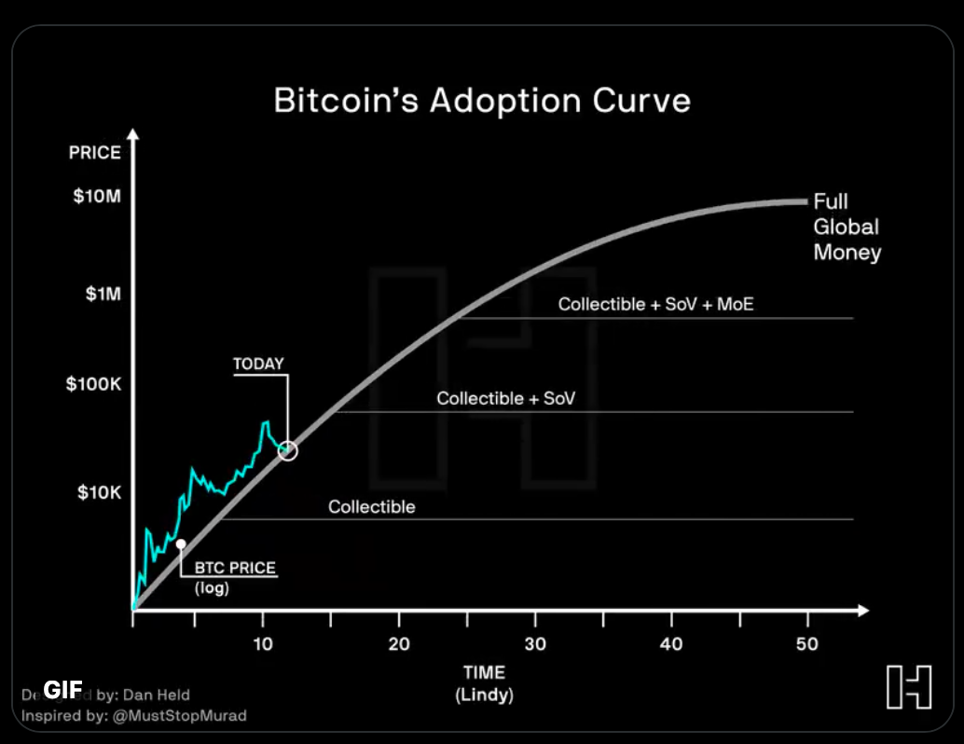
Are We Firing the Fed?

Slide 16
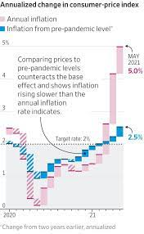
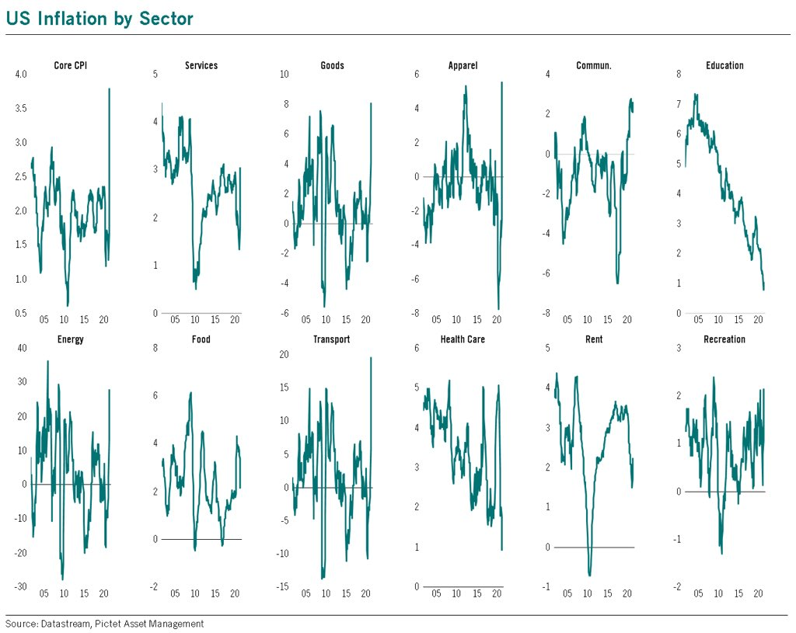
What is the Real Deal With Inflation?
Dapena, Kara, and Peter Santilli. “Rising Inflation Looks Less Severe Using Pre-Pandemic Comparisons.” The Wall Street Journal, Dow Jones & Company, 22 June 2021, www.wsj.com/articles/inflation-rates-fed-11624304034.
@BittelJulien, Twitter, June 10, 2021

Slide 17
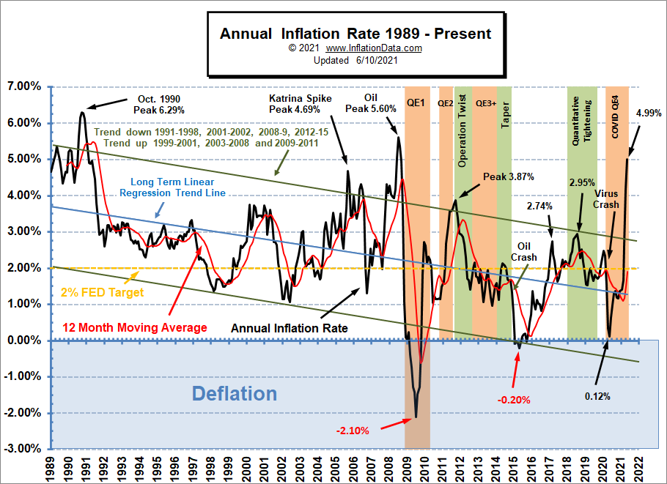
Inflation Should Be Through the Roof
“Annual Inflation.” InflationData.com, 11 June 2021, inflationdata.com/articles/charts/annual-inflation/.

Slide 18
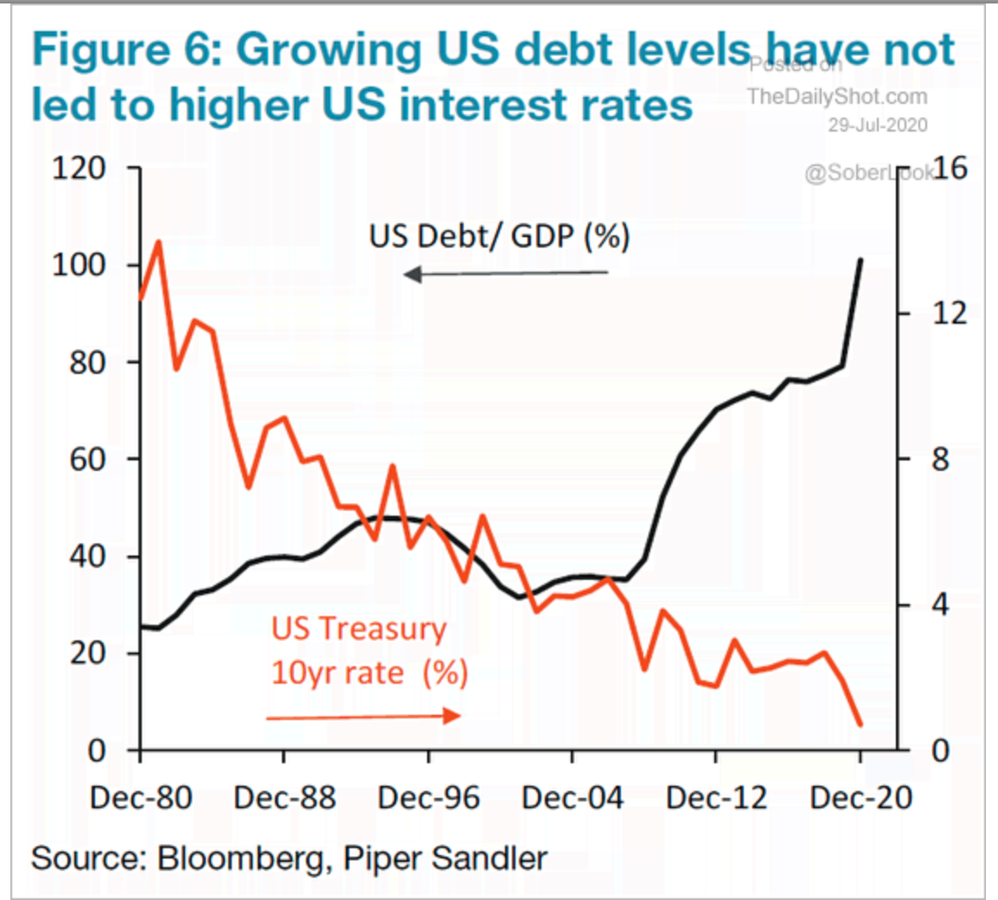
This is Not Supposed to Happen
“U.S. Debt-to-GDP vs. U.S. Treasury 10-Year Rate.” ISABELNET, 29 July 2020, www.isabelnet.com/u-s-debt-to-gdp-vs-u-s-treasury-10-year-rate/.

Slide 20
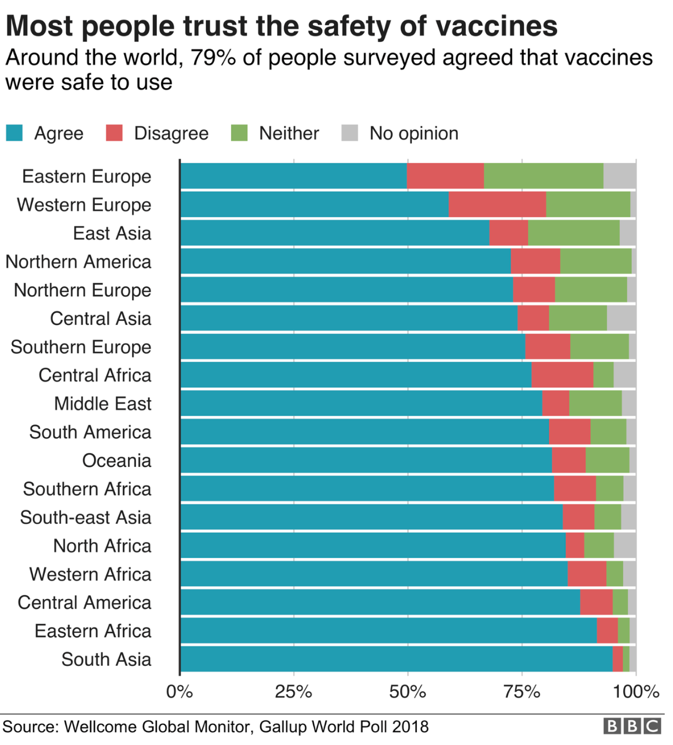
Are We Going to Take the Shot(s)?
Roberts, Michelle. “Vaccines: Low Trust in Vaccination 'a Global Crisis'.” BBC News, BBC, 19 June 2019, www.bbc.com/news/health-48512923.

Slide 21
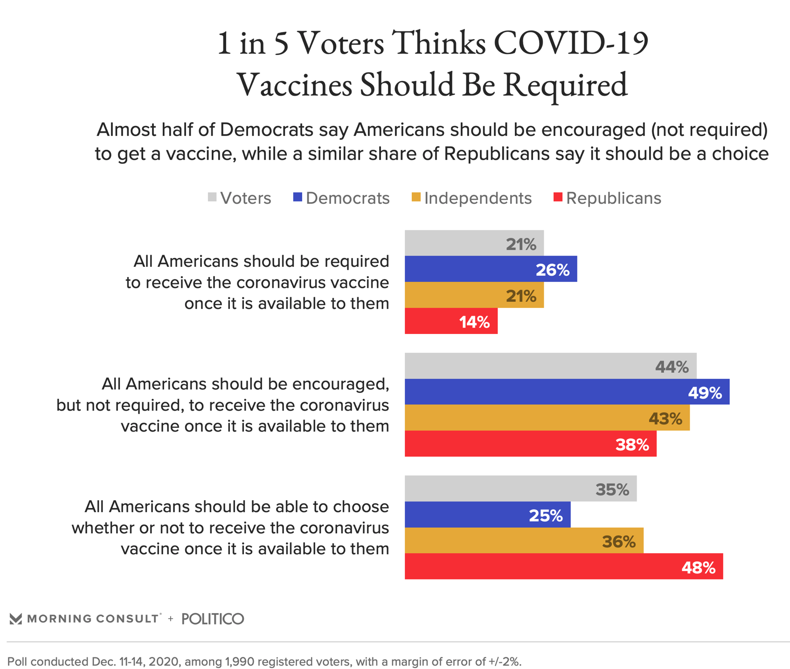
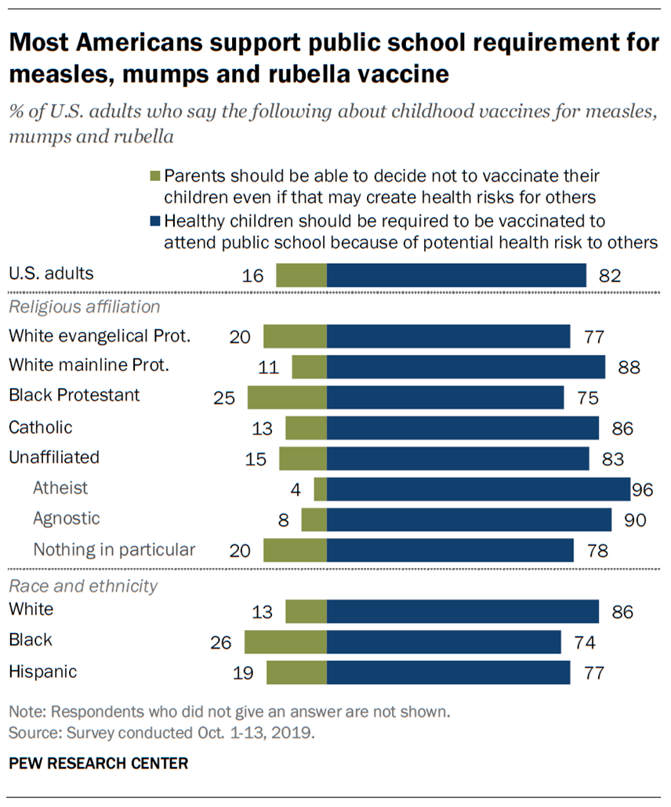
COVID Vaccines Are Special…
Galvin, Gaby. “About 3 in 5 Voters Would Support COVID-19 Vaccination Card Requirement.” Morning Consult, 15 Dec. 2020, morningconsult.com/2020/12/16/covid-19-vaccine-requirement-cards-polling/.
Hefferon, Meg, and Cary Funk. “More Americans Now See 'Very High' Preventive Health Benefits from Measles Vaccine.” Pew Research Center, Pew Research Center, 27 Aug. 2020, www.pewresearch.org/fact-tank/2020/01/07/more-americans-now-see-very-high-preventive-health-benefits-from-measles-vaccine/.

Slide 23
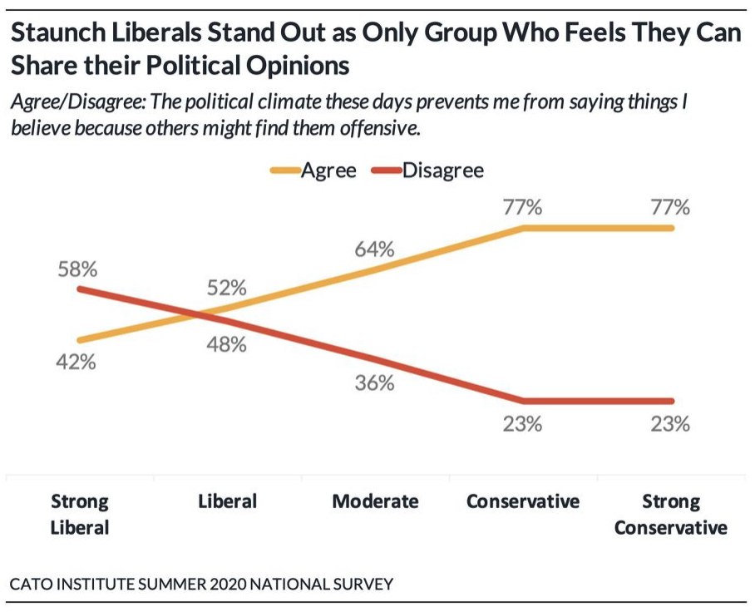
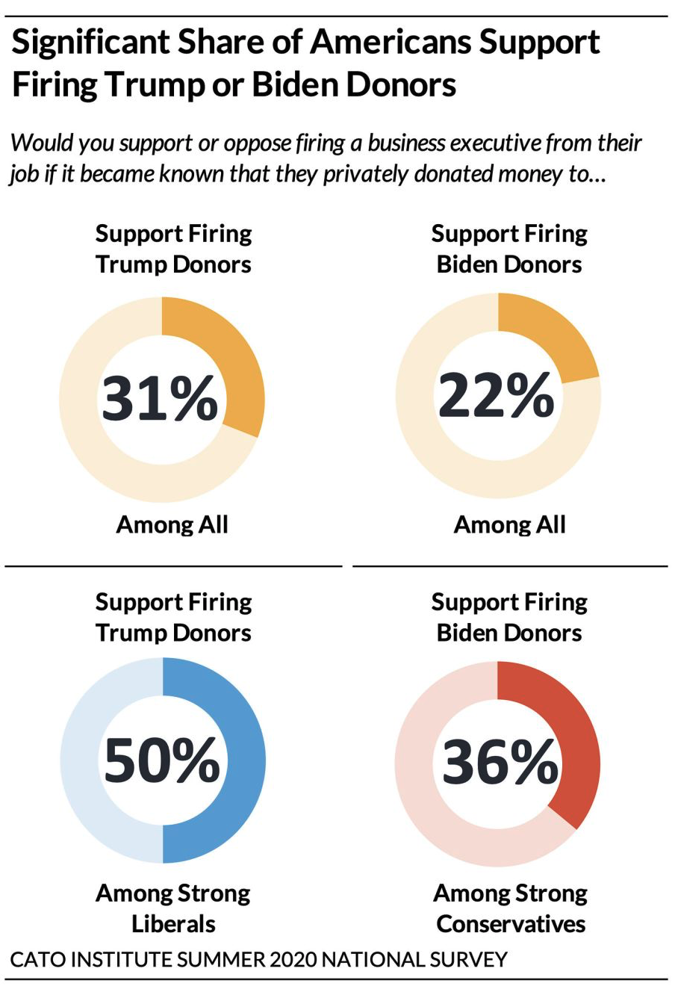
Are We Canceling for Good?
Ebersol, Phil. “'Cancel' Culture and American Politics.” Phil Ebersole's Blog, 29 July 2020, philebersole.wordpress.com/2020/07/29/cancel-culture-and-american-politics/.

Slide 24
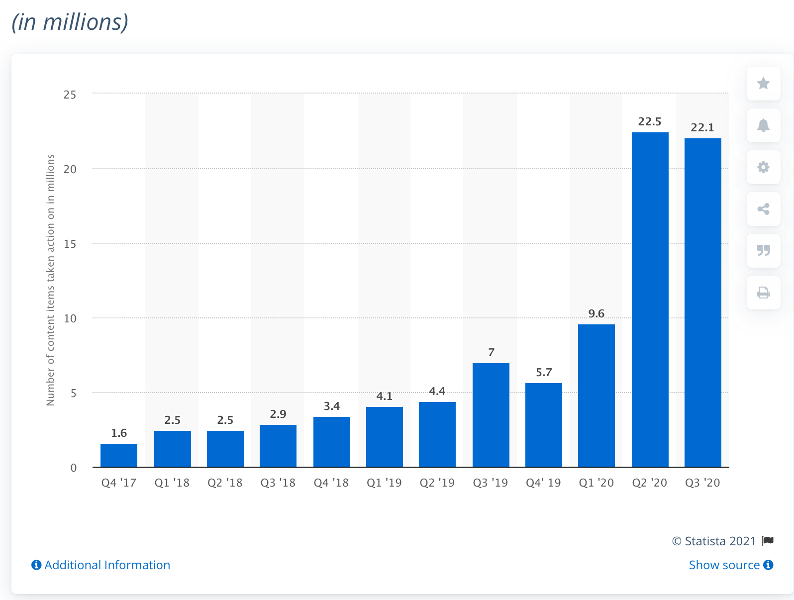
Facebook Intervening in “Hate Speech”
Tankovska, H. “Facebook Hate Speech Removal per Quarter 2020.” Statista, 12 Feb. 2021, www.statista.com/statistics/1013804/facebook-hate-speech-content-deletion-quarter/.

Slide 25
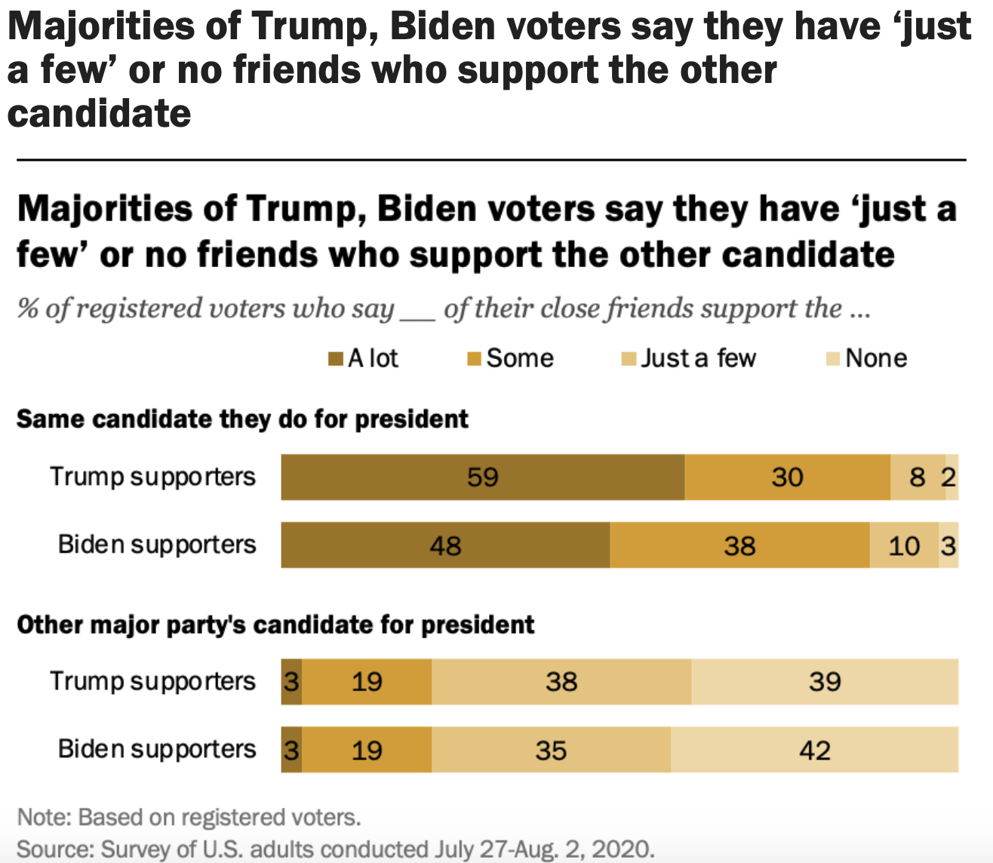
Is There Anyone Left to Cancel?
Smith, Tovia. “Majorities of Trump, Biden Voters Say They Have 'Just a Few' or No Friends Who Support the Other Candidate.” Pew Research Center, Pew Research Center, 18 Sept. 2020, www.pewresearch.org/fact-tank/2020/09/18/few-trump-or-biden-supporters-have-close-friends-who-back-the-opposing-candidate/ft_2020-09-18_friends_01/.

Slide 27
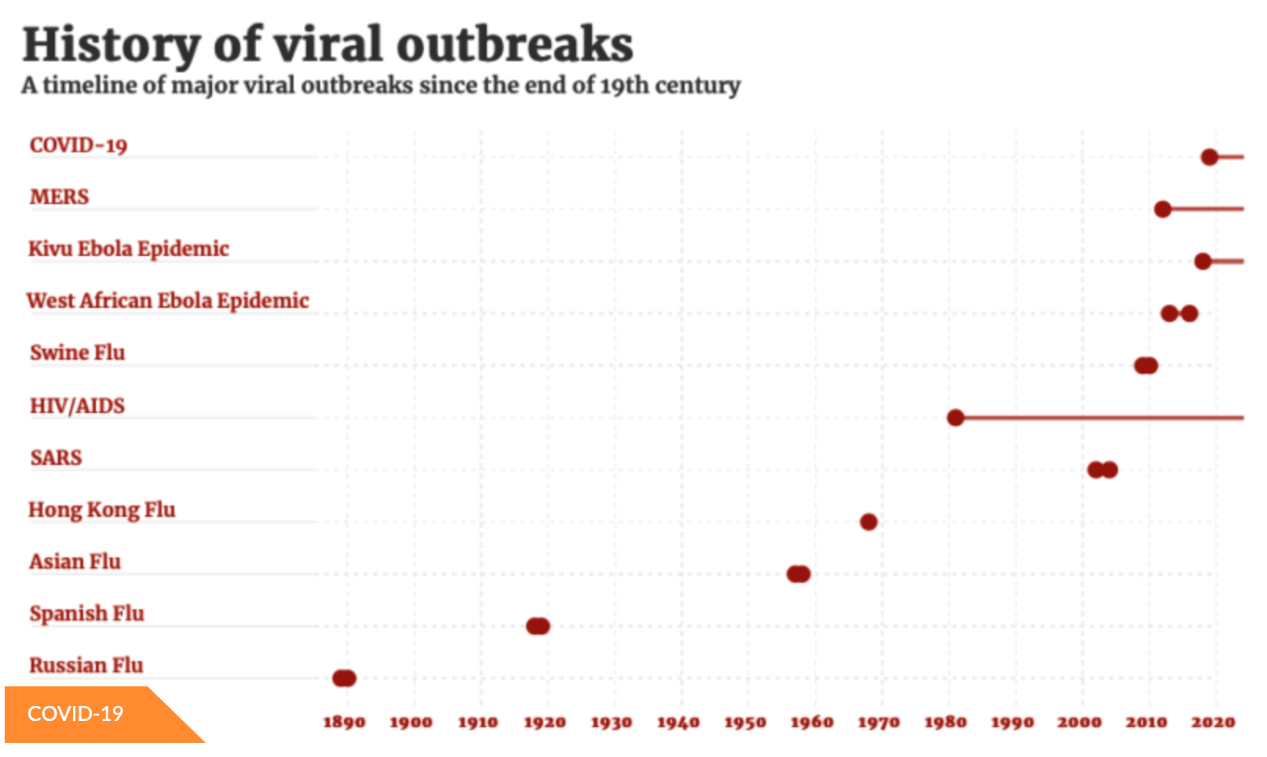
Are We Ready for the Next Outbreak?
Hasmat, Tariq. “Viral Outbreaks: Past Encounters.” Health Analytics Asia, 29 May 2020, www.ha-asia.com/viral-outbreaks-past-encounters/.

Slide 28
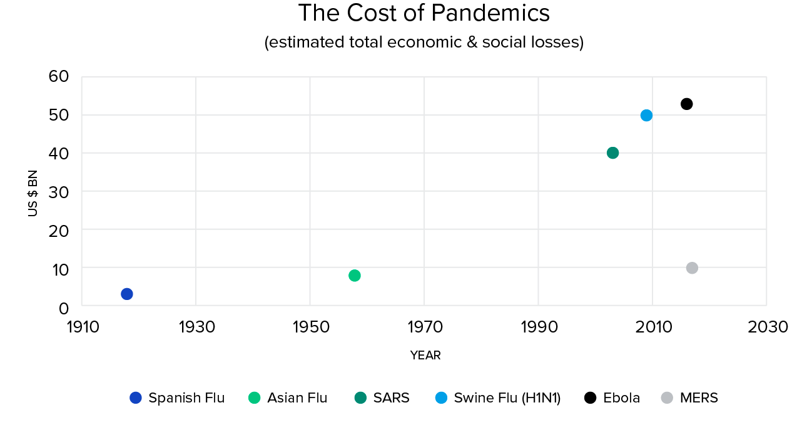
Pandemics Have Been Trending More Expensive
Schwarzburg, Martin. “Pandemics in History: Assessing the Cost.” Toptal Finance Blog, Toptal, 9 Apr. 2020, www.toptal.com/finance/market-research-analysts/pandemic-cost.

Slide 29
Is Pandemic Preparedness Worth the Cost?
U.S. Cost of COVID =
$3.2 - $4.8 Trillion
Walmsley, Terrie, et al. “The Impacts of the Coronavirus on the Economy of the United States.” Economics of Disasters and Climate Change, 2020, doi:10.1007/s41885-020-00080-1.
“The US National Academy of Medicine estimates that committing an incremental US $4.5 billion annually to be used primarily for strengthening national public health systems, funding R&D, and financing global coordination and contingency efforts would significantly reduce the severity of future outbreaks.”
Schwarzburg, Martin. “Pandemics in History: Assessing the Cost.” Toptal Finance Blog, Toptal, 9 Apr. 2020, www.toptal.com/finance/market-research-analysts/pandemic-cost.

Slide 31
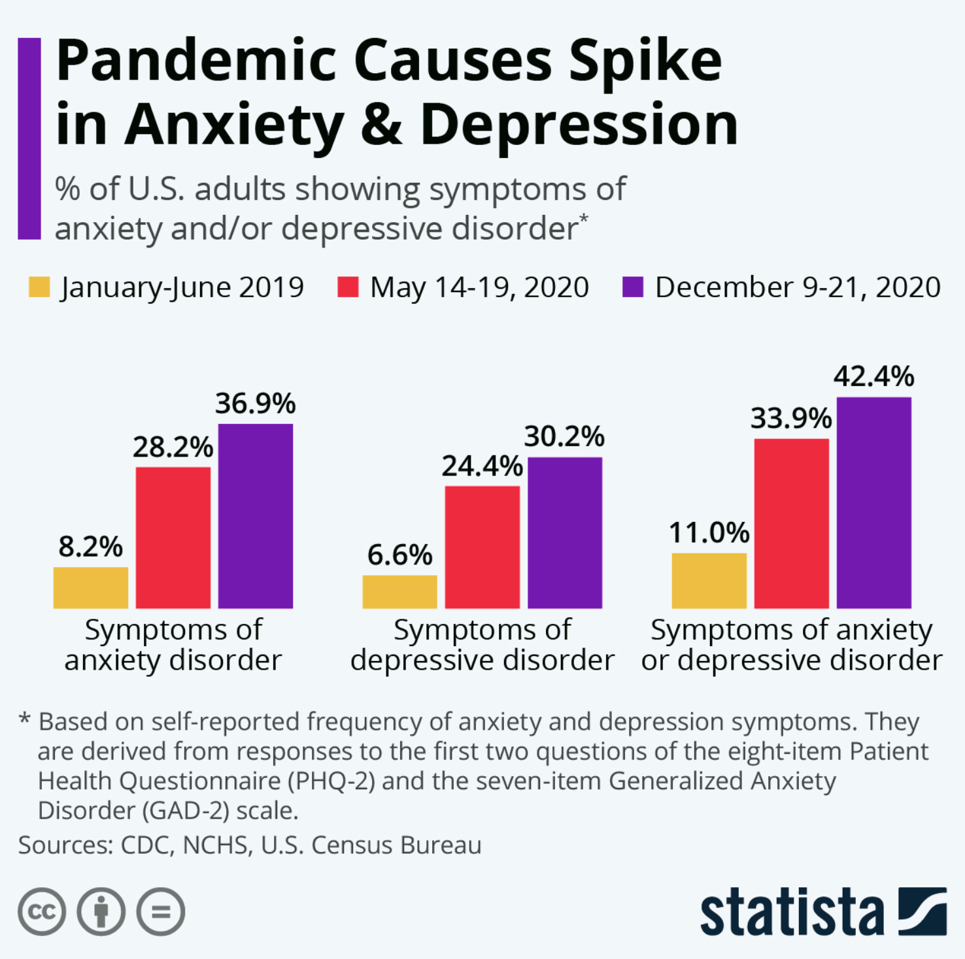
The Mental Toll of the Pandemic
Richter, Felix. “Infographic: Pandemic Causes Spike in Anxiety & Depression.” Statista Infographics, 18 Jan. 2021, www.statista.com/chart/21878/impact-of-coronavirus-pandemic-on-mental-health/.

Slide 32
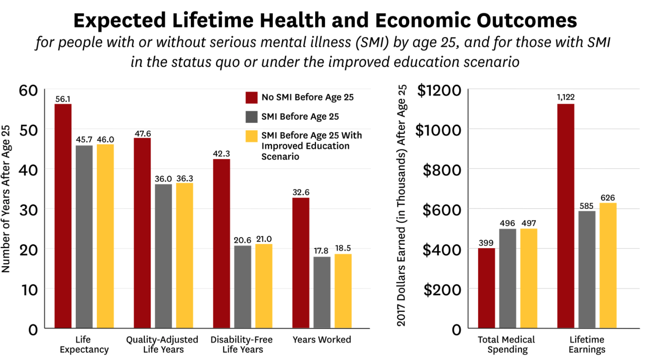
Mental Illness Impairs Economic Success
Seabury, Seth, et al. “Measuring The Lifetime Costs Of Serious Mental Illness And The Mitigating Effects Of Educational Attainment.” USC Schaeffer, 28 May 2019, healthpolicy.usc.edu/research/measuring-the-lifetime-costs-of-serious-mental-illness-and-the-mitigating-effects-of-educational-attainment/.

Slide 33
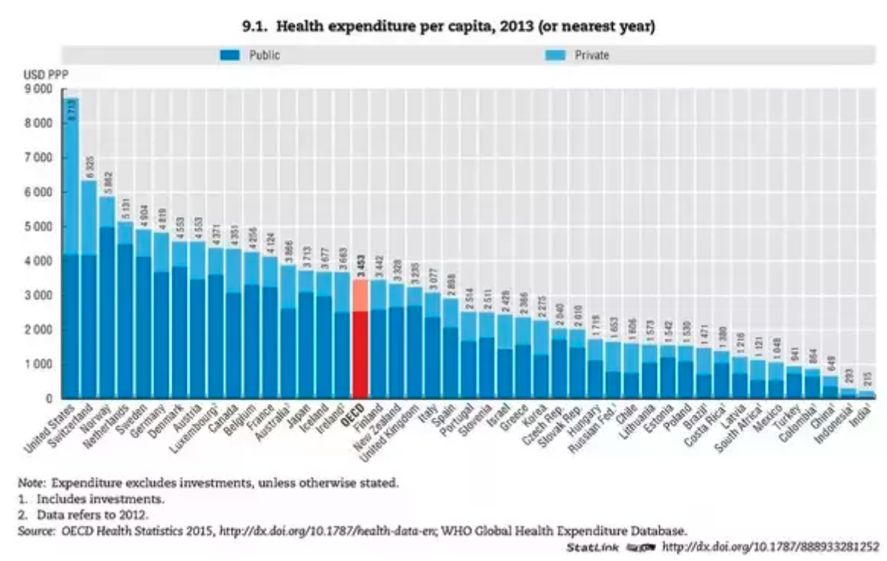
The Problem Doesn’t Appear to Be Money

Slide 35
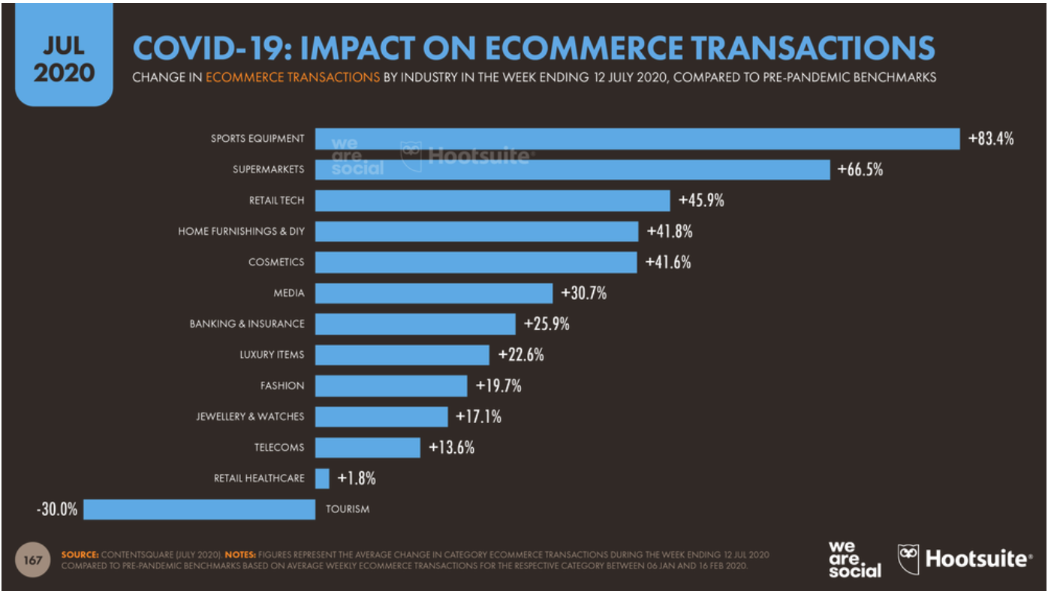
Ecommerce Booms in COVID
Blank, Zach. “X'MAS 2020: Is Your E-Com Startup Ready For Biggest Delivery Season?” Startupanz.com, 2 Dec. 2020, startupanz.com/xmas-2020-e-com-startup-ready-biggest-delivery-season/.

Slide 36
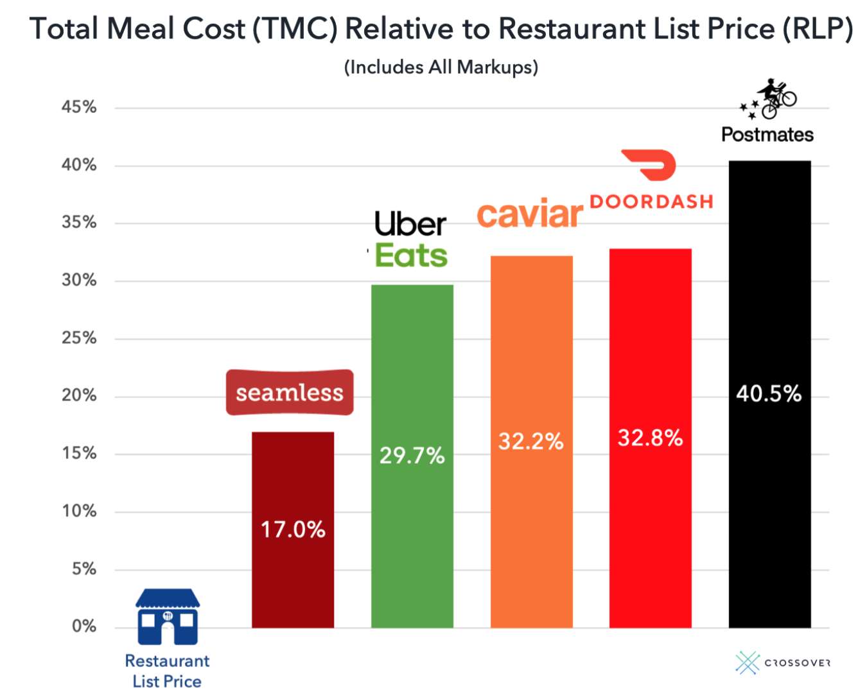
The Price of Convenience
Lichtenstein, Noah. “The Hidden Cost of Food Delivery.” TechCrunch, TechCrunch, 16 Mar. 2020, techcrunch.com/2020/03/16/the-hidden-cost-of-food-delivery/?guccounter=1&guce_referrer=aHR0cHM6Ly93d3cuZ29vZ2xlLmNvbS8&guce_referrer_sig=AQAAAAw-Ksqz3dug6wF6ZL14-ARHGjch92e6qm0fvjfHW_lkd7w1ssa8_mtWlsirz4lcr0Zp8BoiSVAdwk58ayUr00LQCCcONyk4XSyPa5yVbRfA1epSyKJQez-kRQYLq5FGaTYm6_9CP1Rz-jZtFMhgXQHpzx7OhWHHnXGensS3YY--.

Slide 37
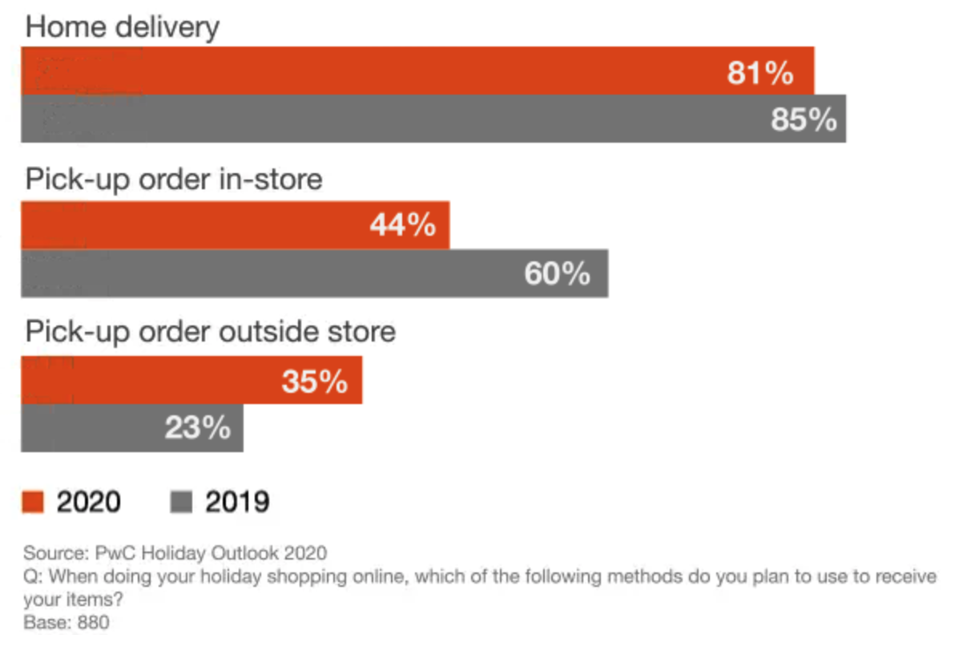
It’s Unclear if People Want to Pick Up at the Store
Cornell, Tyson. “2020 Holiday Outlook October.” PwC, Oct. 2020, www.pwc.com/us/en/industries/consumer-markets/library/2020-holiday-outlook/october.html.

Slide 38
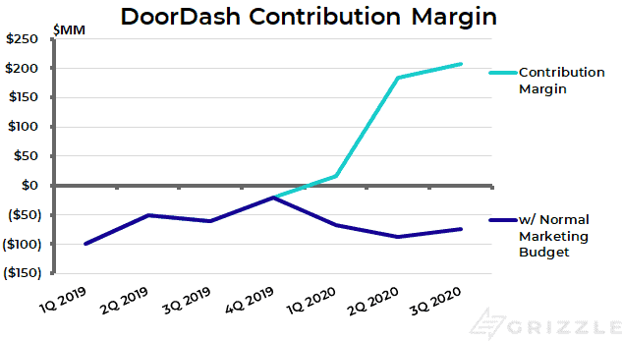
When Will DoorDash Be Profitable?
Fernando, Chris, et al. “DoorDash IPO - Another SoftBank Pump and Dump.” Grizzle, 7 Dec. 2020, grizzle.com/what-3-things-will-cause-doordash-dash-ipo-to-fail/.

Slide 40
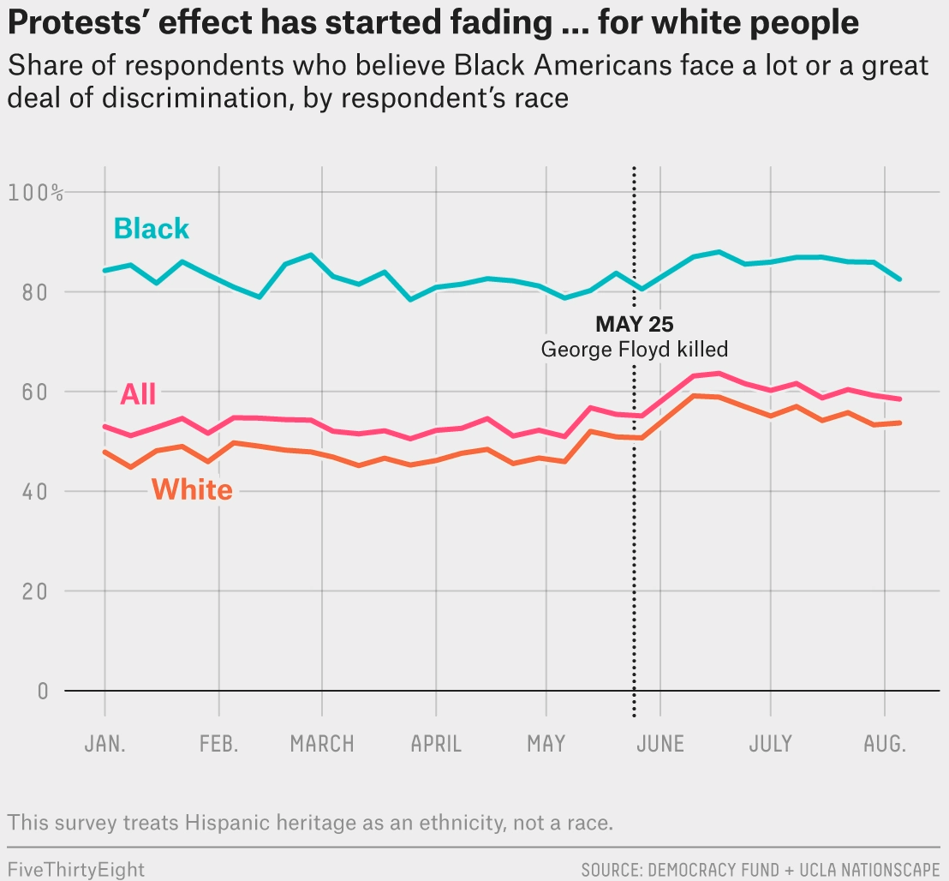
Are We Going to Act on Race?
Tesler, Michael. “Support For Black Lives Matter Surged During Protests, But Is Waning Among White Americans.” FiveThirtyEight, FiveThirtyEight, 19 Aug. 2020, fivethirtyeight.com/features/support-for-black-lives-matter-surged-during-protests-but-is-waning-among-white-americans/.

Slide 41
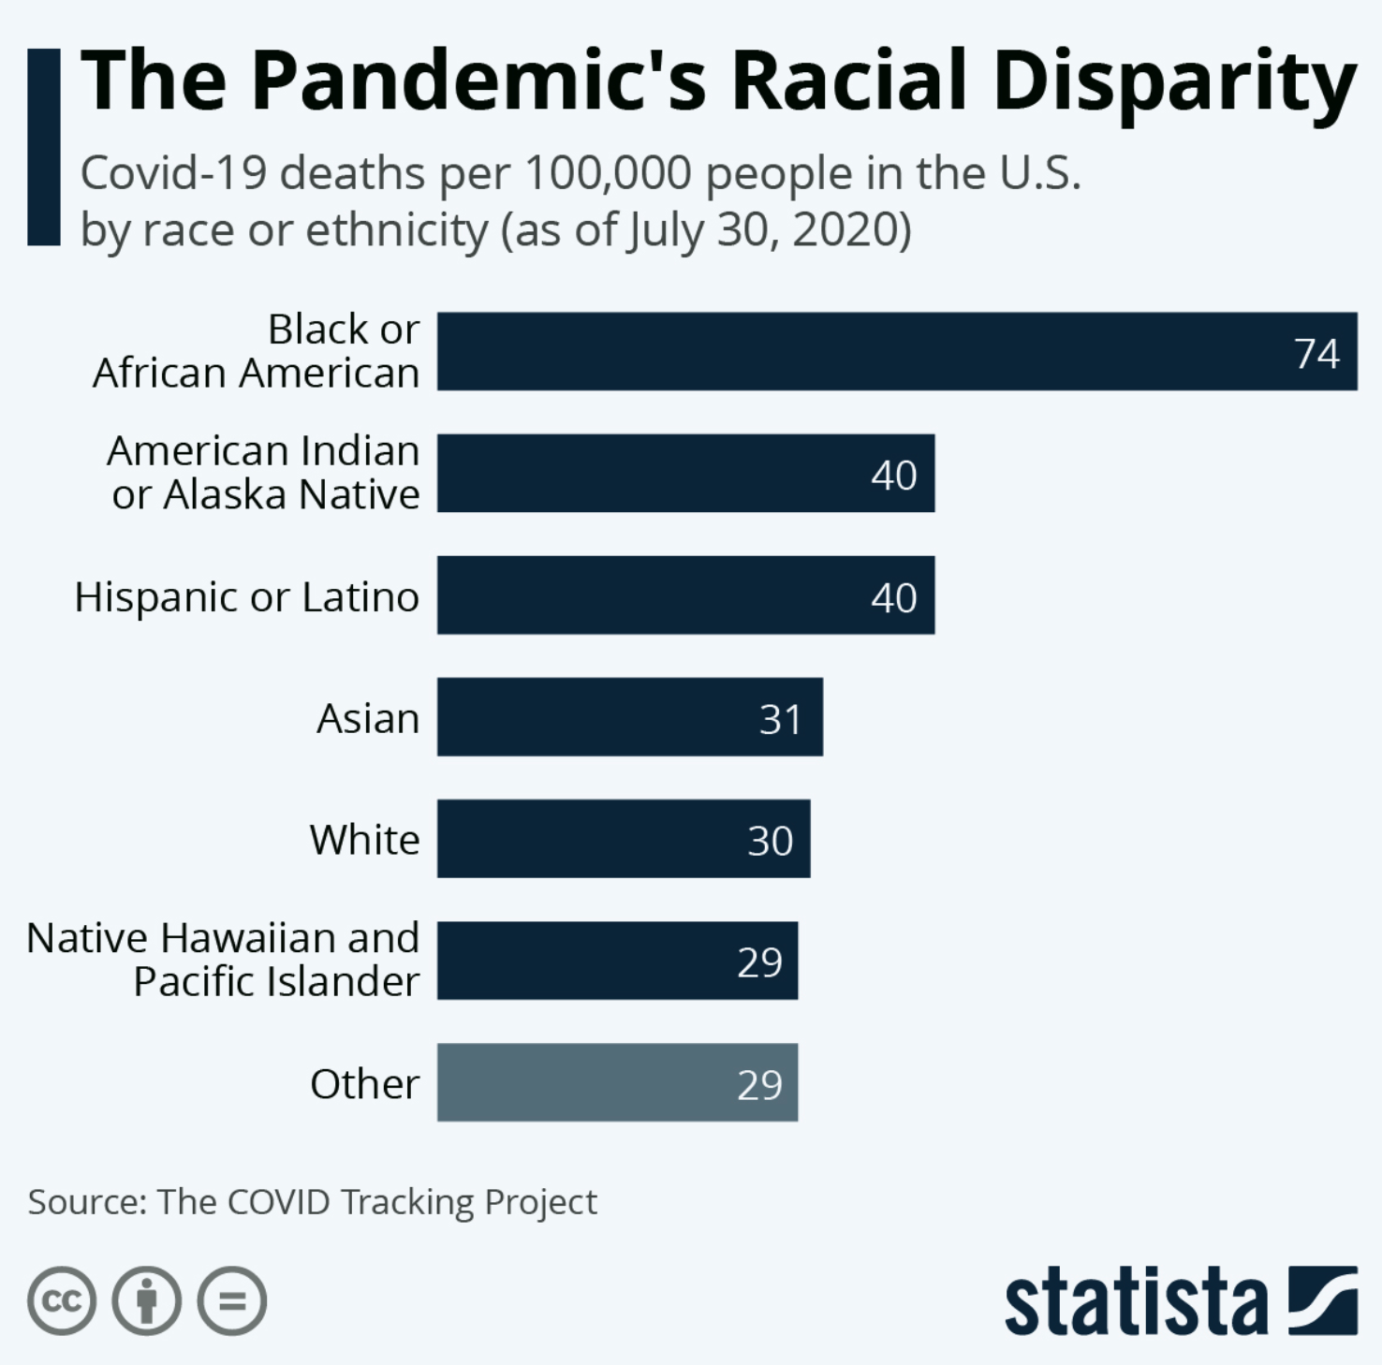
COVID Did Not Treat Everyone Equally
McCarthy, Niall, and Felix Richter. “Infographic: The Pandemic's Racial Disparity.” Statista Infographics, 30 July 2020, www.statista.com/chart/22430/coronavirus-deaths-by-race-in-the-us/.

Slide 42
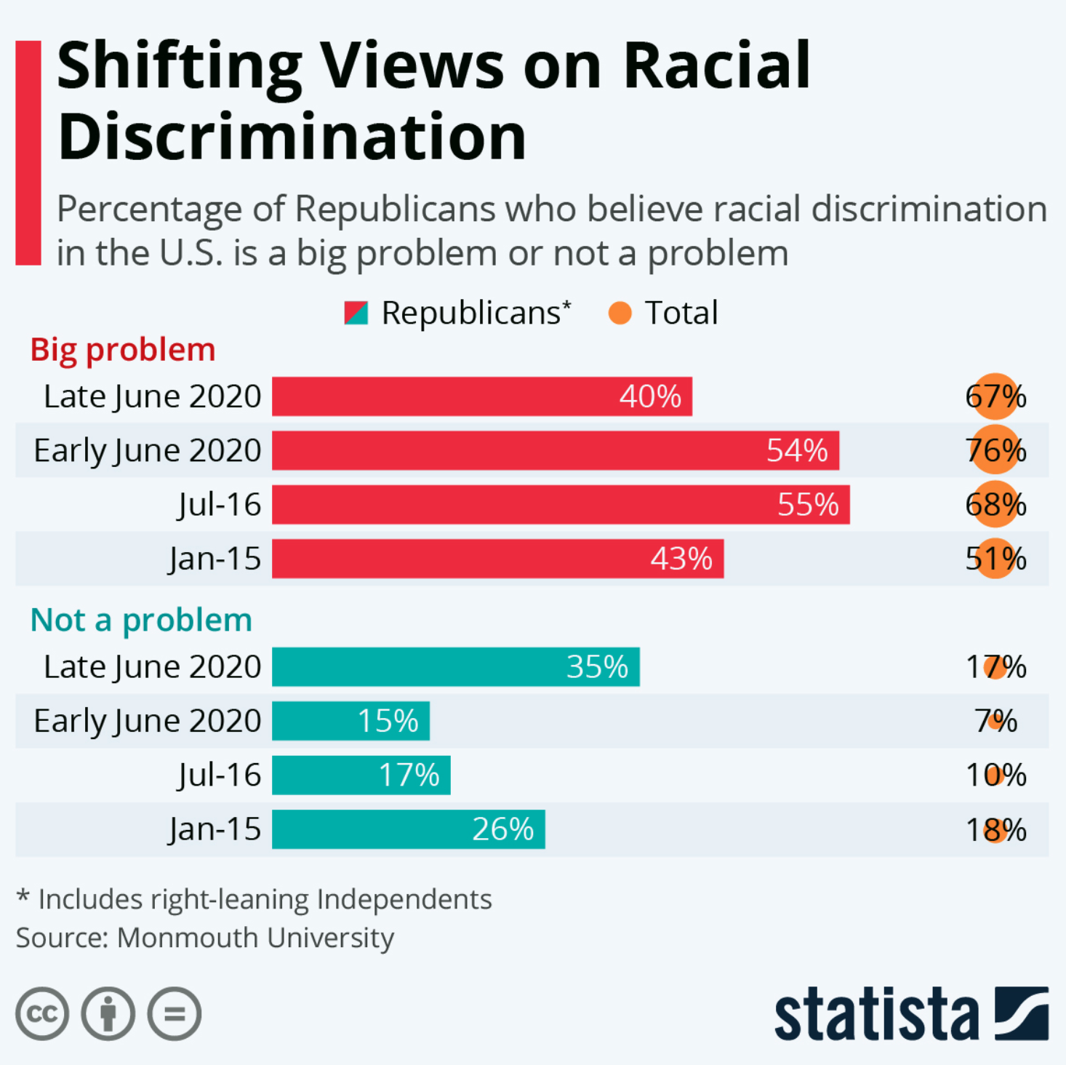
A Big Shift in Attitude
Roper, Willem, and Felix Richter. “Infographic: Shifting Views on Racial Discrimination.” Statista Infographics, 9 July 2020, www.statista.com/chart/22237/republicans-views-racial-discrimination/.

Slide 44
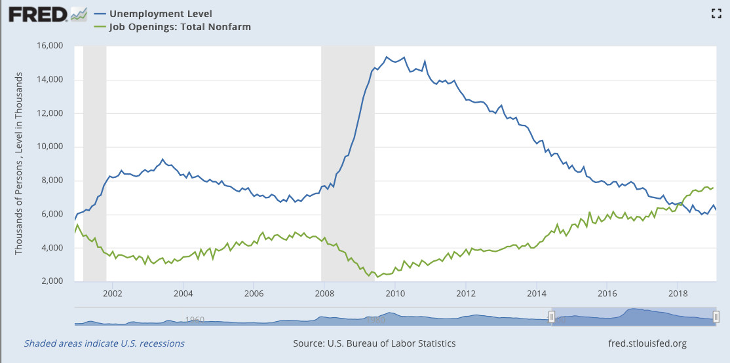
Will We Lure or Force People Back to Work?
Source: St. Louis Federal Reserve

Slide 45
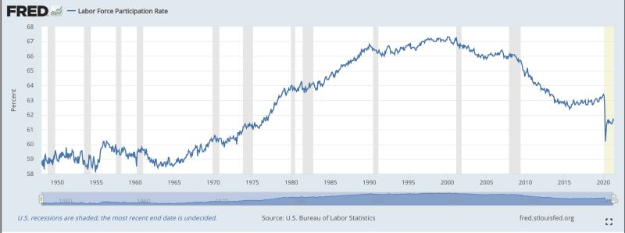
The Labor Force Has Declined for 20 Years
Source: St. Louis Federal Reserve

Slide 46
We Don’t Know The Story Yet
Narratives appear to be purely ideological
Unemployment benefits are too high OR
People have woken up and have changed priorities and are willing to give up income for a different lifestyle (typically the case for 2 income families)
We won’t know until
2-3 months pass after states reduce unemployment benefits and
Schools re-open
More of the population is vaccinated

Slide 47
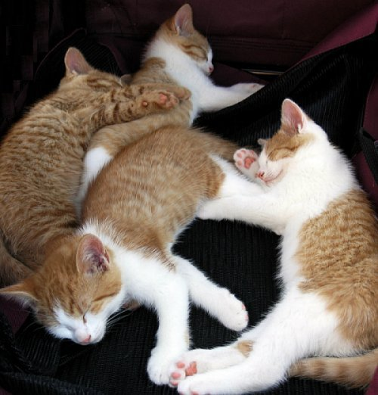
Thanks!
Follow me on LinkedIn for Chart of the Day!
Questions?
Michael Blake
msblake@bradyware.com
@unblakeable
Podcast: Decision Vision

Slide 48
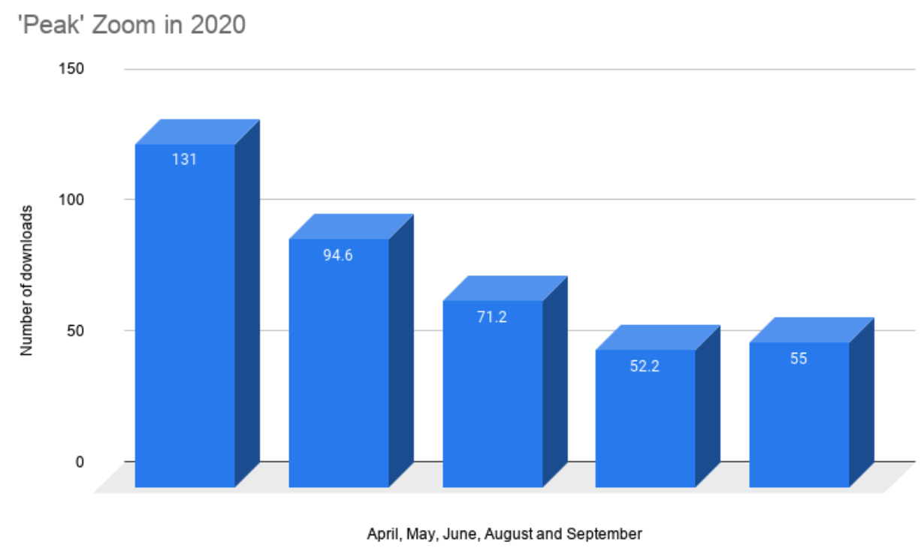
Are We Keeping Video Calls?
“How Zoom May Be the Biggest Tech Success Story of 2020 - Latest News: Gadgets Now.” Gadget Now, 28 Dec. 2020, www.gadgetsnow.com/tech-news/how-zoom-may-be-the-biggest-tech-success-story-of-2020/articleshow/79987385.cms.

